Slide 1
Progress in the Breadth: Broadening the Scope of Language Understanding
Daniel Khashabi Allen Institute for AI Joint w/ Swaroop Mishra, Tushar Khot, Ashish Sabharwal, Hanna Hajishirzi, Oyvind Tafjord, Peter Clark
Notes:
Glad to be here. If you have any clarification questions, please interrupt me; otherwise, let’s delay all the open-ended questions till after the talk.
- before I start, let me mention that these are joint work with a bunch of folks that you probably know.
Just to set the expectation, I have very little talk about wrp to IR.

Slide 2
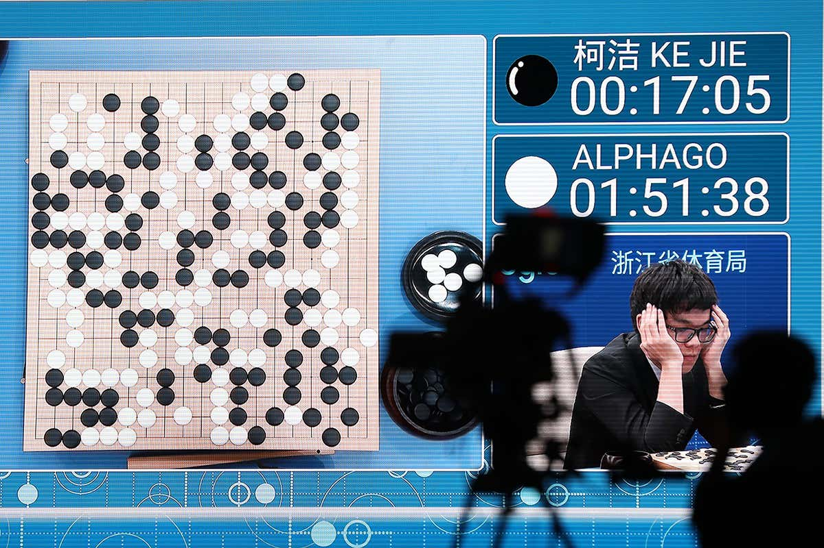
AlphaGo: The Success
Notes:
Let me start by remembering one of the widely-known successes of AI.
Just a few years ago, AlphaGO defeated the human world champion, in the ancient game of Go, followed by lots of excitement about the new heights that AI has achieved.

Slide 3
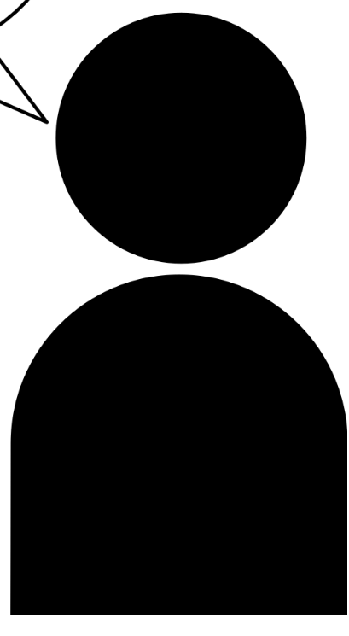

AlphaGo: The Not-So-Successful Story
Can AlphaGo solve any problem?
Can you help me with my presentation?
??
Can you play poker?
??
Can you tell me about the game you’re good at?
💤
AlphaGo is incapable of solving any other problem in the world.
Notes:
While AlphaGo is an exciting breakthrough, it is fair to ask whether it can solve any other problem?:
Can it help me with my presentation?
Can it play poker?
Can it explain the game it is good at? (it can't even explain itself)
Technologies like AlphaGo, as impressive as they are in what they do, they’re quite narrow. AlphaGo is incapable of solving any other problem in the world.

Slide 4
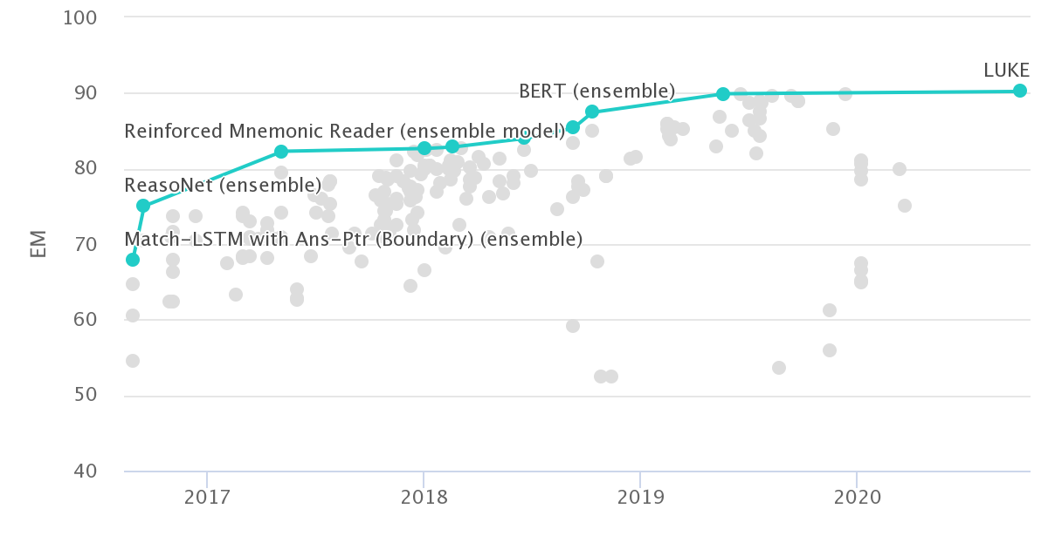
The Progress in NLP/QA
Many benchmarks in NLP:
SQuAD [Rajpurkar et al. 2016]
ARC [Clark et al. 2018]
DROP [Dua et al. 2019]
…
SQuAD leaderboard
Notes:
Similarly, in the past few years we have built many benchmarks for NLP.
And for each of these challenges, we have built systems that can achieve incredible performance.

Slide 5
Limits of Our Progress
Successes in NLP are focused on niche domains
language understanding tasks
🤮
HotpotQA
Multi-hop reasoning
SQuAD
Predicate/argument structure
NarrativeQA
Narrative understanding
DROP
Arithmetic reasoning
Notes:
The downside is that all the major successes in NLP are focused on niche domains.
For example, if you build a model for SQuAD, it wouldn’t work on HotPotQA.
There is something odd about claiming that we (the community) are making progress in terms of “language understanding”, when the resulting models can’t simultaneously understand other reasoning problems (such as: numerical reasoning, compositional reasoning, etc.)
After all, all these are different, but relevant aspects of language understanding.

Slide 6
Breadth of tasks
language understanding problems
puzzles/search problems
SQuAD
HotPotQA
Go
Chess
Depth of tasks
Notes:
Let me show the same point pictorially:
Think of this light blue shape as the space of all the problems we’re interested in.
The X-axis is the collection of problem definitions, or the metaphorical breadth of problems.
For example, problem definitions for Go, for SQuAD, or any other QA task.
The depth is the complexity of each problem space.
For example, within the domain defined by the rules of Go.
Similarly, for any NLP task.
The issue I am alarmed by is that we excessively focus on depth,
We try to make the most sophisticated Go player
Similarly, for NLP models, we try to make the strongest models (for each dataset)
But very little time is spent in the breadth, i.e., building models that support a border range of tasks (i.e., more breads).

Slide 7
This Talk
In the current state of NLP field, we do not focus enough on the “breadth” of our progress.
Transfer Across QA Formats
Generalization to Unseen NLP Tasks
Broadening scope of NLU
Notes:
In this talk, I am advocating for more focus on the “breath” of our progress: We need to build models that cover a broader range of tasks.
And I am going to contextualize this broad idea with two recent work on question answering:
In the first part, I am going to talk about transfer between different QA formats.
Then in the 2nd part I am going to introduce a paradigm for inducing generalization across a variety of NLU tasks.
In terms of technical details, these two projects are accomplishing two different tasks. But they are united in that, they are different approaches to broadening the scope of NLU.

Slide 8
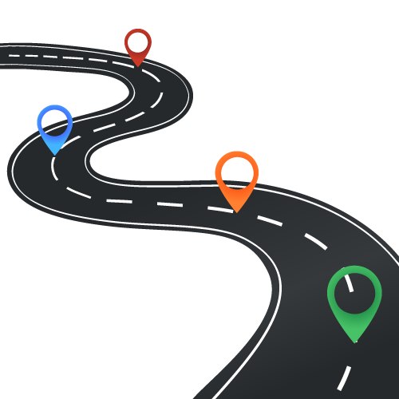
This Talk
▣ Introduction
▢ Transfer Across Formats
▢ Generalization to Unseen Tasks
▢ Big Picture

Slide 9
Transfer Across QA Formats
K et al. UnifiedQA: Crossing Format Boundaries With a Single QA System. EMNLP-Findings 2020.

Slide 10
Many Flavors of QA
…
…
OBQA
BoolQ
NarQA
DROP
SQuAD1
SQuAD 2
ComQA
…
TREC-8
TREC-9
TREC-2001-2005.
MCTest
RACE
ARC
WinoGrande
2000 2005 2010 2015 2020
Notes:
In recent years, the community has built many QA datasets.

Slide 11
Many Flavors of QA
…
…
OBQA
BoolQ
NarQA
DROP
SQuAD1
SQuAD 2
ComQA
…
TREC-8
TREC-9
TREC-2001-2005.
MCTest
RACE
ARC
WinoGrande
2000 2005 2010 2015 2020
Question: “At what speed did the turbine operate?”
“16,000 rpm”
Candidates: (Nikola_Tesla) On his 50th birthday in 1906, Tesla demonstrated his 200 horsepower (150 kilowatts) 16,000 rpm bladeless turbine. ...
[Rajpurkar et al. 2016]
Notes:
For example, the SQuAD dataset popularized the extractive format, where each question comes with an accompanying paragraph that is supposed to explicitly contain the answer to the question.

Slide 12
Many Flavors of QA
…
…
OBQA
BoolQ
NarQA
DROP
SQuAD1
SQuAD 2
ComQA
…
TREC-8
TREC-9
TREC-2001-2005.
MCTest
RACE
ARC
WinoGrande
2000 2005 2010 2015 2020
Question: “What does photosynthesis produce that helps plants grow? ”
“The big kid”
Candidates: (A) water (B) oxygen (C) protein (D) sugar
[Clark et al. 2018]
Notes:
Multiple-choice questions should be a a familiar variant of QA to us;
A question is supplemented with a bunch of candidate answers

Slide 13
Many Flavors of QA
…
…
OBQA
BoolQ
Motivations for publishing new datasets:
Unexplored reasoning challenges
Alternate (better?) evaluation protocols
NarQA
DROP
SQuAD1
SQuAD 2
ComQA
…
TREC-8
TREC-9
TREC-2001-2005.
MCTest
RACE
ARC
WinoGrande
2000 2005 2010 2015 2020
But inherently they’re all QA!
Notes:
Essentially, each new dataset offers an alternate (better?) evaluation protocol for a slightly different phenomenon.
But inherently, they’re different realization of the same task (namely, QA).

Slide 14
Format-Specific Model Design
Consequences of format-specific designs:
Prevent generalization across formats
Don’t benefit from labeled data of other formats
Input
Task-specific layer
format | assumption
Yes/No QA
Multiple-choice QA
Extractive QA
Abstractive QA
binary output
One correct answer from a list of candidates.
answer is a substring of paragraph
answer to be inferred from the paragraph
Dataset-specific assumptions 😢
Notes:
Somehow the field has become “dataset” driven:
And consequently, we (the community) accepted that it is okay to encode dataset-specific assumptions into models.
For example: people who solve yes/no datasets (read)
We (the community) frequently exploit these assumptions that move our models away from the broad definition of QA.
And there are consequence to such narrow designs;
Format-specific assumptions create hard barriers for generalization of systems across formats.
A system engineered for YN cannot run on SQuAD questions.
Additionally, there is a missed opportunity here; as I will show later; by making QA systems more general we can build stronger models, partly because we can access a larger pool of data for supervision.

Slide 15
Format-Specific Model Design (2)
ExtractiveQA
Question: “At what speed did the turbine operate?”
(Nikola_Tesla) On his 50th birthday in 1906, Tesla demonstrated his 200 horsepower (150 kilowatts) 16,000 rpm bladeless turbine. …
“16,000 rpm”
MultipleChoiceQA
Question: “What does photosynthesis produce that helps plants grow?”
(A) water (B) oxygen (C) protein (D) sugar
“sugar”
Notes:
Just to say the same thing with a bit more graphics:
Within the boundaries defined by each of the QA formats, we have seen lots of activities.
My argument is that such boundaries, in many cases, are artificial and perhaps unnecessary, given that there is a lot of sharedness among the these tasks. So we’re gonna try to tear down these walls.

Slide 16
Beyond Format-Specialized Models
ExtractiveQA
Question: “At what speed did the turbine operate?”
(Nikola_Tesla) On his 50th birthday in 1906, Tesla demonstrated his 200 horsepower (150 kilowatts) 16,000 rpm bladeless turbine. …
“16,000 rpm”
MultipleChoiceQA
Question: “What does photosynthesis produce that helps plants grow?”
(A) water (B) oxygen (C) protein (D) sugar
“sugar”
Notes:
Enabled by this intuition, we built a system that performs surprisingly well across four different QA formats.

Slide 17
UnifiedQA: Definition
It’s a single system that is supposed to work on a variety of QA formats.
The input should be natural.
Minimal-enough for a human solver to infer the format.
What causes sound?
(A) sunlight (B) vibrations (C) x-rays (D) pitch
“vibrations”
Notes:
Let’s start with the high-level definition of the system I have in mind.
It’s a single system that is supposed to work on a variety of QA formats.
The input should be naturally readable; basically humans should be able to answer each format by just reading the input.
Let's see an example.
(read it)
Humans don't need to be told that this is a multiple-choice question. You just read it and infer it.
And that's what I expect a system to be able to do, as well.

Slide 18
UnifiedQA: Definition
It’s a single system that is supposed to work on a variety of QA formats.
The input should be natural.
Minimal-enough for a human solver to infer the format.
Is Jamaica considered part of the United States?
(Jamaica) Jamaica (/dʒəˈmeɪkə/ ( listen)) is an island country situated in the Caribbean Sea...
“no”
Notes:
Here is another example,
(read it)
Again, humans don't need to be told that it is yes/no question. They can infer it from the input.

Slide 19
UnifiedQA: Definition
It’s a single system that is supposed to work on a variety of QA formats.
The input should be natural.
Minimal-enough for a human solver to infer the format.
Use text-to-text architectures: T5 [Raffal et al. 2020], BART [Lewis et al. 2019], etc.
Our encoding:
Text-in, text-out
The question always comes first.
Additional info are appended with “\n”.
What type of musical instruments did the Yuan bring to China?
(Yuan_dynasty) Western musical instruments were introduced to enrich Chinese performing arts....
“Western musical instruments”
Notes:
Here is another one:
(read)
Again you don't need to know what is the format or the dataset. But one can infer it from what is shown as input.
Overall, all these examples illustrate our encoding of the instances when we feed them to the models.
(read)
Let me emphasize that: In this encoding, we never explicitly mention the format of a given instance or what dataset it belongs to. It is something that needs to be inferred.
The key technical requisite that we’re borrowing from the field is text-to-text architectures, such as T5, BART

Slide 20
Experiment: Mixing Pairs of Formats
Is there any value in out-of-format training?
70
65
60
55
50
Mixing RACE (Multiple-Choice) w/ datasets of different formats.
69.4
62.5
59.1
Trained on RACE
55.8
Trained on RACE + SQuAD 1
RACE
MCTest
[Lai et al. 17]
[Richardson et al. 15]
Notes:
The first intuition that one needs to verify is whether there is any value in mixing pairs of datasets.
(read the plots)
I don’t know about you, but when I was seeing these improvements, my first instinct was that there must be a bug somewhere.
Quite surprising how one can gain so much by creating these seemingly odd combinations.
--> more experiments in the paper Overall, empirically we see that there exists pairs of datasets with different formats that benefit from each other.
This brings us to the question of what happens when you mix multiple datasets of different format?

Slide 21
UnifiedQA-v1
Trained on the union of different formats:
Extractive: SQuAD 1.1, SQuAD 2.0
Abstractive: NarrativeQA
Multiple-choice: RACE, ARC, OBQA, MCTest
YesNo: BoolQ
* Rajpurkar et al. ‘16 & ‘18; Kociský et al. ‘18; Lai et al. ‘17; Clark et al. ‘18; Mihaylov et al. ‘18; Richardson et al. ‘13; Clark et al. ‘19
Notes:
Motivated by the previous observations, we build systems trained on a mix of many formats.
We build UnifiedQA, by training our models on the union of the following 8 datasets.
For the rest of this section, I am going to show several empirical intuitions on UQA.

Slide 22
Experiment: Comparison w/ Dedicated Models
Is UnifiedQA as good as systems dedicated to individual datasets?
UnifiedQA performs almost as well as individual T5 models targeted to each dataset.
Notes:
Is UQA as good as dedicated systems trained for individual datasets?
In this plot,
The BLUE bars belong to UQA (a single system for multiple datasets of different formats).
The GREEN bars are dataset-specific models; i.e., models that are evaluated on the same dataset that they were trained on.
The results show that UQA performs almost as well as targeted models.
On average (the right columns) UQA clearly outperforms dataset/format-specific systems.
Overall, UQA offers flexibility across multiple QA formats while compromising almost none compared to dataset-specific experts.

Slide 23
Experiment: Fine-tuning UnifiedQA
Is there value in using UnifiedQA as a starting point for fine-tuning?
Show SOTA on 10 datasets (OBQA, QASC, RACE, WinoGrande, PIQA, SIQA, ROPES)
Similar trends for BART
85
75
65
87
84
78
79
78
Fine-tuned on T5
70
Fine-tuned UnifiedQA (based on T5)
ARC-chall
CommonsenseQA
OBQA
[Clark et al. 18] [Talmor et al. 19] [Khot et al. 19]
Notes:
What if we only care about a particular benchmark?
is there a value in using UQA as a starting point for fine-tuning?
as opposed to a fine-tuning vanilla language model that is not familiar with the QA task yet?
Here I am showing the results of fine-tuning two systems.
(read the plot)
We see that fine-tuning on UQA consistently dominates fine-tuning on T5.
Intuitively, since UQA has had exposure to different formats, it is well-positioned to achieve higher scores after a little fine-tuning.
This is especially effective when a user has limited training data for their target QA task
We have an extensive experiments on this if you look at our paper, where we report SOTA scores on 10 dataset.
There are other experiments that I am not going to show due to my limited time:

Slide 24
Earlier Work on Multi-task Learning
In the same spirit as multi-task learning
They usually don’t work! 😭
The choice of tasks is also important.
Earlier works select too broad of tasks.
E.g., [Raffel et al.’19]: diverse NLP tasks (machine translation, summarization, etc) and conclude that a single model for multiple NLP tasks underperform task-specific models.
We choose to stay within the boundaries of QA.
[Caruana '97; McCann et al. ’18]
Didn’t work before; why would it work now? 🤔
Notes:
Before I end, I’ll mention a few words on transfer learning or multi-task learning:
There is a large body of work in this direction that try to exploit the commonalities of the tasks.
My understanding is that the majority of the efforts on multi-task learning don't result in any meaningful gains.
Here you might say, well it seems like you're also doing multi-task learning as well; it didn't for others, why do you think it works for you?
Here is my argument: In most cases, the failure of a multi-task learning (or their success, for that matter) should not be blamed on the algorithms, but rather on the choices of the tasks.
Many works often select an excessively broad set of tasks.
Raffel et al. (2019) experiment with diverse NLP tasks (machine translation, summarization, etc) that have very little in common.
Here, we choose our tasks so that we stay within the boundaries of QA and show that transfer across different QA variants is indeed possible.
That is really the key difference that enables us to show transfer in this study.

Slide 25
Lessons
The field relies excessively on format-specific assumptions for system design.
Creating format-specific QA models distance us from broad QA.
Instead, we should build more general QA architectures → more breadth!
Incentive: there is value in mixing QA datasets of different formats.
UnifiedQA: a single QA system working across four common QA formats
Fine-tuning models pre-trained on UnifiedQA yields SOTA results.
https://github.com/allenai/unifiedqa
Notes:
The field relies excessively on format-specific assumptions for system design. Instead, we should move towards more general QA architectures and push for broader scopes for QA systems.
There is incentive in doing so as well: we showed gains from mixing QA datasets of different formats.
And the by-product of the study is: UnifiedQA, a single pre-trained QA system that works across four common QA formats.

Slide 26
Cross-Task Generalization via Natural Language Instructions
MKBH. Natural-Instructions: Benchmarking Cross-Task Generalization
via Natural Language Instructions. arXiv 2021.

Slide 27
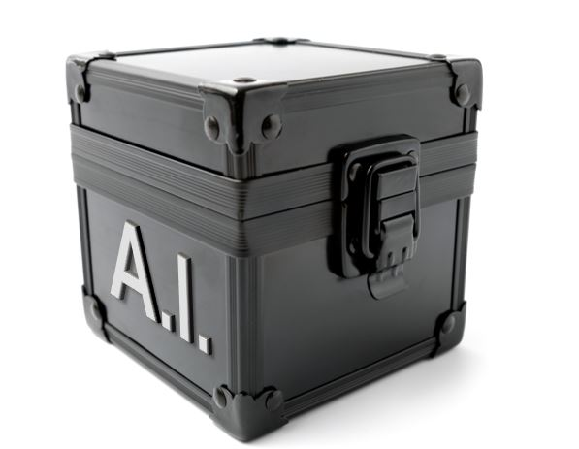
Task-Specific Models
Text: She chose to make a salad for lunch tomorrow and Sunday. Question: how long did it take for her to make a salad?
task title
Question Typing
“event duration”
Task-specific models do not generalize across tasks.
There are MANY tasks!
Question Answering
“30mins”, “an hour”
Grammar Checker
“yes”
Notes:
As you know, there are many tasks that we’d like to solve with our NLP model: …
For example, given this input which contains a text and a question, we we want models that:
give us the semantic type of this question
answer it,
or detect its writing/grammatical issues
and so many others tasks.
In the current conventional paradigm, what build models for each task, typically based based on datasets built for each one.
This convention has had a good run: we have good systems that work well for each dataset
however, it is limiting our progress:
First, task-specific models do not generalize across tasks
e.g., a question-answering model cannot solve classification tasks.
The idea that can have a model per task is just unrealistic and unscalable. There is no way that we can build models for every task. We haven’t even defined what all the tasks are.

Slide 28
Beyond Task-Specific Models
Text: She chose to make a salad for lunch tomorrow and Sunday. Question: how long did it take for her to make a salad?
task title
Question Typing
“event duration”
Question Answering
“30mins”, “an hour”
Grammar Checker
“yes”
Notes:
So, we need a slightly different paradigm for our models.
the eutopia that I am after looks like this
Where we have a single system that has a broader scope, can solve a variety of tasks
But now the problem is that:
the model does not know what task to solve for each input.
to make a model solve a variety of tasks, we should somehow define what expect from the model.

Slide 29
Beyond Task-Specific Models
Text: She chose to make a salad for lunch tomorrow and Sunday. Question: how long did it take for her to make a salad?
task title
Question Typing
question-typing
“event duration”
Question Answering
question-answering
“30mins”, “an hour”
Grammar Checker
grammar-check
“yes”
Do not generalize to “unseen” tasks.
[Raffel et al. 2020]
Notes:
We’re not the first to think about this setup.
For example, Raffel et al (2020) (the T5 paper)
Used task-specific prefixes to to define the tasks
This enabled them to build a single model that functions on a variety of tasks.
However, the model’s scope/generalization is limited to the task it has seen.
It can do “question answering” if it was trained with a dataset that contained this exact prefix.
→ the model does not generalize to unseen tasks
-------------
TODO: there are many flavors of each task. There are many variants of typing task with different type flavors.
TODO: if there is more time, you can also mention NLP decathaton
you can also compare with UnifiedQA
Or you can talk about the vision team’s system

Slide 30
Beyond Task-Specific Models
human readable definitions; fully define the task
Text: She chose to make a salad for lunch tomorrow and Sunday. Question: how long did it take for her to make a salad?
task title
Question Typing Instructions
Indicate the type of temporal phenomenon in the question …
Question Typing
“event duration”
Question Answering Instructions
In this task we ask you to write answer to the given question. …
Question Answering
“30mins”, “an hour”
Grammar Check Instructions
Label a question that is free of any grammatical/logical errors w/ 'yes’ …
Grammar Checker
“yes”
Instructions define a task explicitly in natural language.
Notes:
The setup that we’re exploring here is an extension of the previous idea, where instead of task prefixes we have instructions which define a task explicitly in natural language.
- unlike task prefixed, instructions are human-readable definitions that are expected to fully define the task
# textual descriptions of the target tasks.

Slide 31
Cross-Task Generalization
Text: She chose to make a salad for lunch tomorrow and Sunday. Question: how long did it take for her to make a salad?
task title
Question Typing Instructions
Indicate the type of temporal phenomenon in the question …
Question Typing
“event duration”
Question Answering Instructions
observed
tasks
In this task we ask you to write answer to the given question. …
Question Answering
“30mins”, “an hour”
Grammar Check Instructions
Label a question that is free of any grammatical/logical errors w/ 'yes’ …
Grammar Checker
“yes”
Explicit Answerability Instructions
evaluation
tasks
Respond "yes" if the text contains an explicit answer to the given question. …
Explicit answerability
“no”
Notes:
Now, let’s say I am allowed to use these tasks as a source of supervision for my model.
Given this setup, we define and measure cross-task generalization, as the ability to solve a see unseen task.
If the resulting model, truly makes use of the instructions, it should be able to ”understand” the new task based on its instructions and act accordingly.
You might ask, why is this even possible?
Humans are the real proof of a system that have this kind of generalization. Crowdworkers, for example, simply read textual instructions or example and do annotations tasks. We should be able to do something similar with our NLP technology.
--------------------------------------
So, this should define my setup. Let’s see how we’re going to study this.

Slide 32
Instructions Paradigm: Challenges
There is no benchmarks containing natural language instructions for a diverse range of of tasks.
Unclear whether models benefit from task “instructions”
Instructions are hard to learn!
We present a dataset of natural instructions with a wide variety of tasks!
We show empirical evidence of their benefits!
Notes:
There are two key limitations along the path towards studying our problem. …

Slide 33

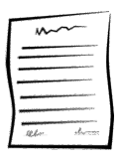
Natural-Instructions: Overview
Contains:
61 tasks and instructions
160k instances (input -> outputs)
Use existing datasets and the instructions used to crowdsource them
(Efrat & Levy, 2020)
Input
Output
A typical data construction pipeline
Notes:
We introduce a dataset that we called “natural instructions”.
which contains …
In the next few slides I am going to explain how we put together this dataset.
Our construction was motivated by the observation that humans (e.g., crowdworkers) can read and act according to these crowdsourcing instructions.
We’re not the first to think about this idea.
For instance, Efrat & Levy also thought along similar lines.
... but this is the first time that is done in this scale AND also leads to positive results in terms of model generalization.
I should be clear that, the process of converting existing datasets to “natural instructions” is not a trivial one.
Which is why I am going present high-levels of how it was done.
------------
Should this crowdsourcing picture move to the next slide?

Slide 34
Natural-Instructions: Construction (1)
collecting existing datasets
Contacted dataset authors to access their crowdsourcing instructions and the associated annotations
CosmosQA [Huang et al. 2019]
DROP [Dua et al. 2019]
Essential-Terms [Khashabi et al. 2017]
MCTACO [Zhou et al. 2019]
MultiRC [Khashabi et al. 2018]
QASC [Khot et al. 2020]
Quoref [Dasigi et al. 2019]
ROPES [Lin et al. 2019]
Winogrande [Sakaguchi et al. 2020]
dividing crowdsourcing instructions into minimal tasks
instructions schema
mapping crowdsourcing instructions to the schema
Notes:
We contacted the authors of several recent datasets and obtained the instructions that were used for crowdsourcing them.
As you can see, the list is a bit skewed towards QA datasets. It’s not by design, but rather, these were more available to us.

Slide 35
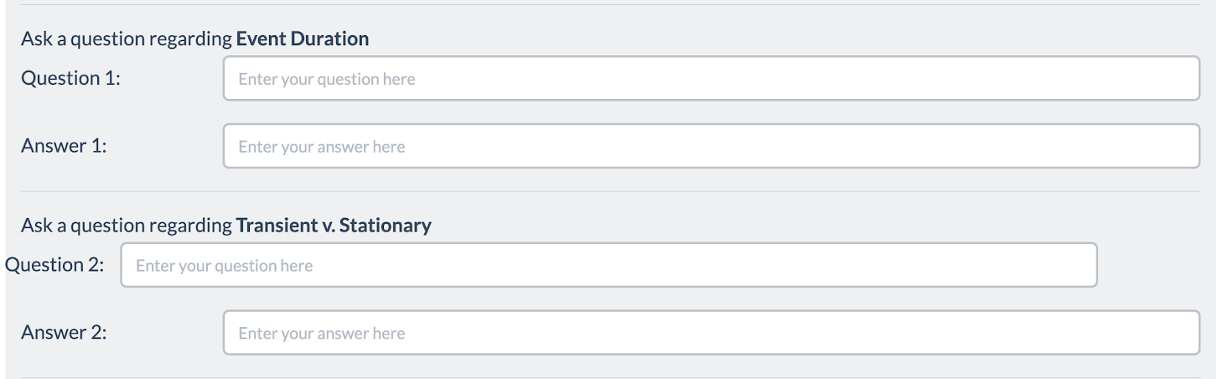
Natural-Instructions: Construction (2)
collecting existing datasets
Crowdsourcing instructions tend to involve multiple annotation steps.
Split them to self-contained tasks:
Input of each task: external data or annotations from earlier tasks
Output of each task: crowdworker annotations
dividing crowdsourcing instructions into minimal tasks
Task1
instructions schema
Task2
MC-TACO
[Zhou et al. 2019]
Task3
Task4
mapping crowdsourcing instructions to the schema
Notes:
Next, we observed that, ….
---------------
TODO:
- you may wanna show statistics on the number tasks per dataset
- I think we can use the examples in Table 1

Slide 36
Natural-Instructions: Construction (2)
collecting existing datasets
Crowdsourcing instructions tend to involve multiple annotation steps.
Split them to self-contained tasks
Input of each task: external data or annotations from earlier tasks
Output of each task: crowdworker annotations
Overall: 9 datasets → 61 tasks
dividing crowdsourcing instructions into minimal tasks
topic word generation
combing facts
question generation
answer generation
Incorrect answer generation
instructions schema
crowdsourcing instructions
for QASC [Khot et al. 2020]
mapping crowdsourcing instructions to the schema
Notes:
By this kind of splitting, we extract a variety of tasks from crowdsourcing templates of a dataset.
For example, in QASC: ....
-------------
TODO:
- you may wanna show statistics on the number tasks per dataset
- I think we can use the examples in Table 1

Slide 37
Natural-Instructions: Construction (3)
instructions schema
collecting existing datasets
Definition
Things to Avoid
Emphasize/Caution
Prompt
Positive Examples:
Negative Examples:
Positive example
Positive example
dividing crowdsourcing instructions into minimal tasks
Input
Output
Input
Output
Reason
Reason
Suggestion
instructions schema
Crowdsourcing instructions: to be converted into plain text.
Can’t easily be automated.
A unified schema for consistent representation across tasks.
mapping crowdsourcing instructions to the schema
Notes:
As you probably know, crowdsourcing instructions are HTML documents that need to convert them plain text.
But this is not something that we can easily automate, since are written by various authors for purposes, and they are different in a variety of ways. So, it’s something that we had to do manually.
Additionally, we created a unified schema to create a consistent representation of all of our instructions.
TODO:
- make it a bit more compact
- just like fig 3, separate instances from the instructions
- we can say: Our instruction schema is the result of our pilot study conducted on a subset of datasets. B

Slide 38
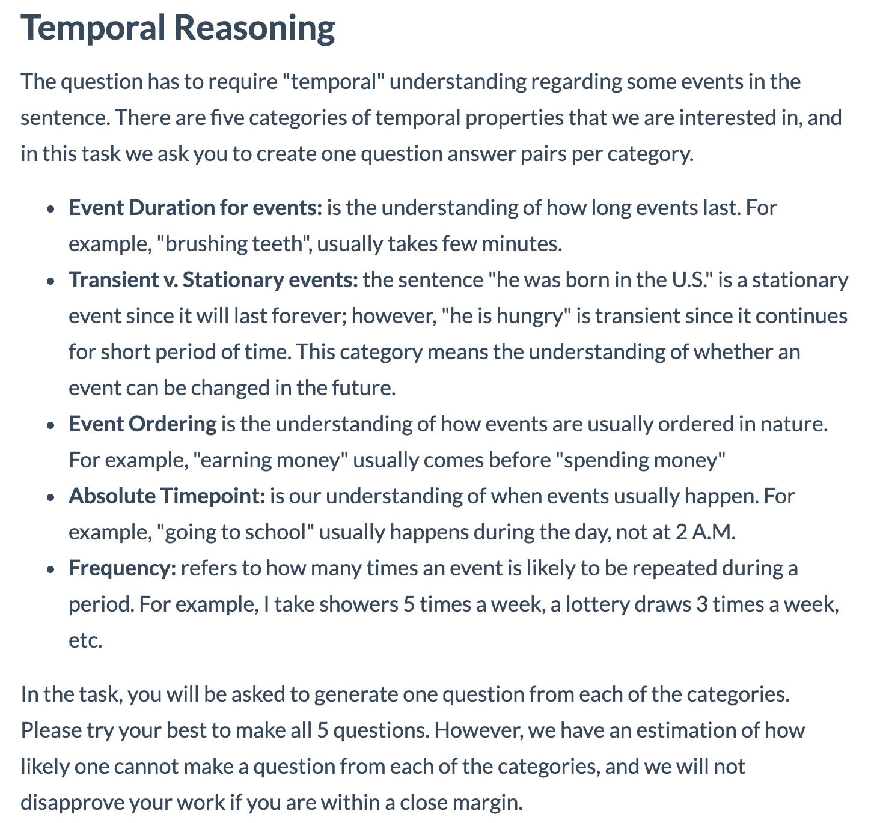
Natural-Instructions: Construction (3)
instructions schema
collecting existing datasets
Definition
Things to Avoid
Emphasize/Caution
Prompt
Positive Examples:
Negative Examples:
Positive example
Positive example
dividing crowdsourcing instructions into minimal tasks
Input
Output
Input
Output
Reason
Reason
Suggestion
instructions schema
mapping crowdsourcing instructions to the schema
MC-TACO [Zhou et al. 2019]
Notes:
• DEFINITION provides the core detailed instructions for a task.
--------------------
TODO:
- make it a bit more compact
- just like fig 3, separate instances from the instructions
We drop uncessary sentences:
E.g., below we provide some examples:

Slide 39
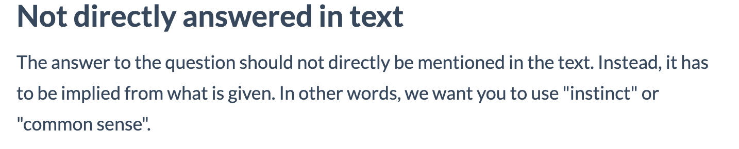
Natural-Instructions: Construction (3)
instructions schema
collecting existing datasets
Definition
Things to Avoid
Emphasize/Caution
Prompt
Positive Examples:
Negative Examples:
Positive example
Positive example
dividing crowdsourcing instructions into minimal tasks
Input
Output
Input
Output
Reason
Reason
Suggestion
instructions schema
mapping crowdsourcing instructions to the schema
MC-TACO [Zhou et al. 2019]
Notes:
THINGS TO AVOID contain instructions regarding undesirable annotations that must be avoided.
These are helpful in defining the scope of a task and the space of acceptable responses.
EMPHASIS AND CAUTION are short, but important statements highlighted in the crowdsourcing templates which were intended to be emphasized.
PROMPT is a single sentence command that often appears before the input instance and connects it to the instructions
--------------------
TODO:
- make it a bit more compact
- just like fig 3, separate instances from the instructions
We drop uncessary sentences:
E.g., below we provide some examples:

Slide 40
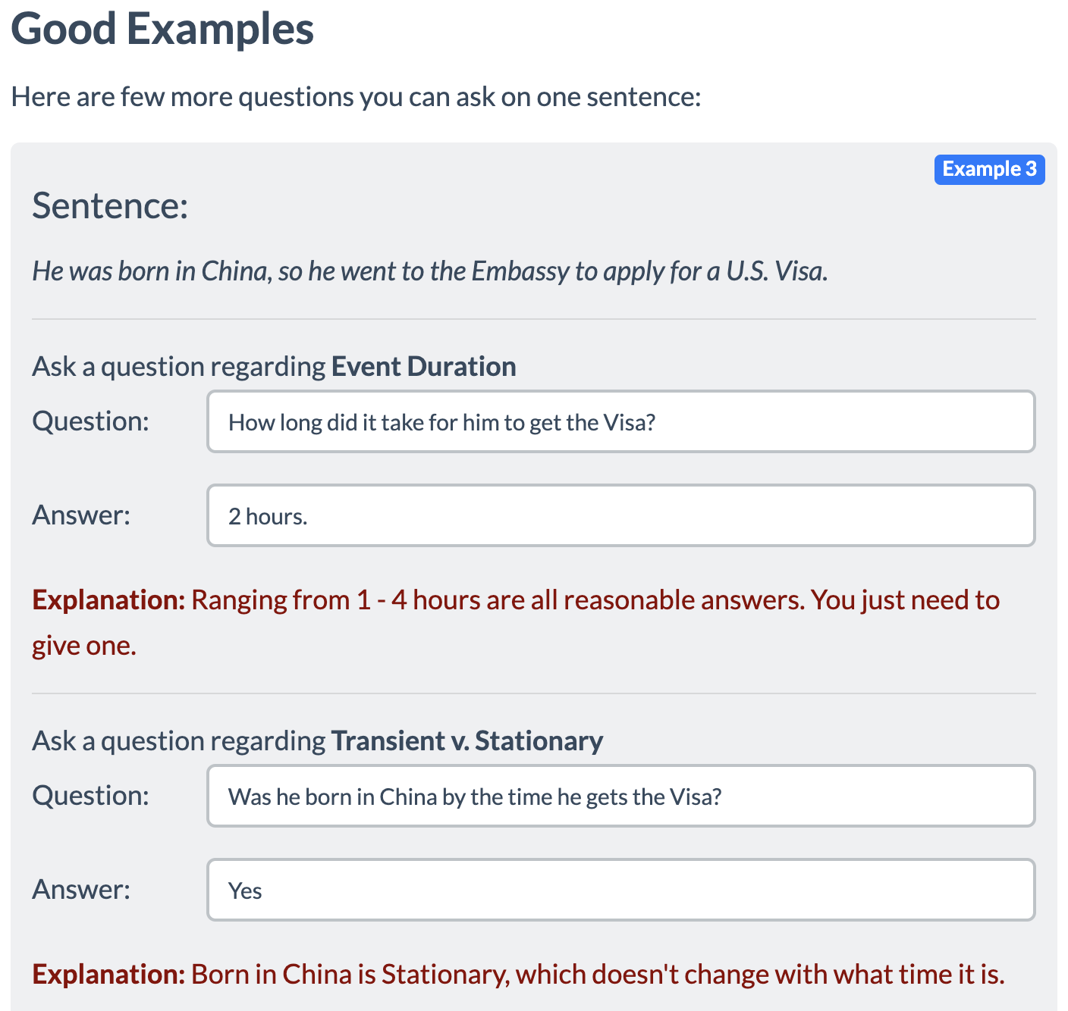
Natural-Instructions: Construction (3)
instructions schema
collecting existing datasets
Definition
Things to Avoid
Emphasize/Caution
Prompt
Positive Examples:
Negative Examples:
Positive example
Positive example
dividing crowdsourcing instructions into minimal tasks
Input
Output
Input
Output
Reason
Reason
Suggestion
instructions schema
mapping crowdsourcing instructions to the schema
MC-TACO [Zhou et al. 2019]
Notes:
• POSITIVE EXAMPLES contain inputs/outputs similar to the input given to a worker/system and its expected output, helping crowdworkers better understand a task
------------------
TODO:
- make it a bit more compact
- just like fig 3, separate instances from the instructions
We drop uncessary sentences:
E.g., below we provide some examples:

Slide 41
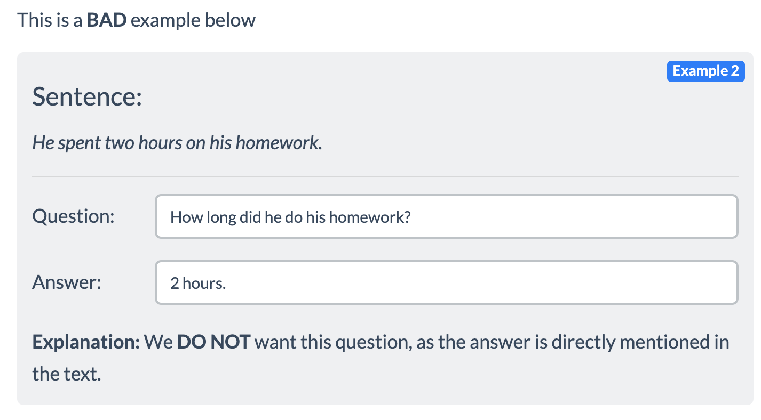
Natural-Instructions: Construction (3)
instructions schema
collecting existing datasets
Definition
Things to Avoid
Emphasize/Caution
Prompt
Positive Examples:
Negative Examples:
Positive example
Positive example
dividing crowdsourcing instructions into minimal tasks
Input
Output
Input
Output
Reason
Reason
Suggestion
instructions schema
mapping crowdsourcing instructions to the schema
MC-TACO [Zhou et al. 2019]
Notes:
NEGATIVE EXAMPLES contain input/outputs to emphasize THINGS TO AVOID by providing examples that must not be produced.
------------------
TODO:
- make it a bit more compact
- just like fig 3, separate instances from the instructions
We drop uncessary sentences:
E.g., below we provide some examples:

Slide 42
Natural-Instructions: Construction (4)
collecting existing datasets
Mapping crowdsourcing instructions to our schema:
Retained the original phrasing.
Redacted verbose/repetitive content.
Created negative examples wherever they were absent.
This process was done by an expert annotator and verified by another.
Took ~20 hours for each task
dividing crowdsourcing instructions into minimal tasks
instructions schema
mapping crowdsourcing instructions to the schema
Notes:
TODO:
- make it a bit more compact
- just like fig 3, separate instances from the instructions
We drop uncessary sentences:
E.g., below we provide some examples:

Slide 43
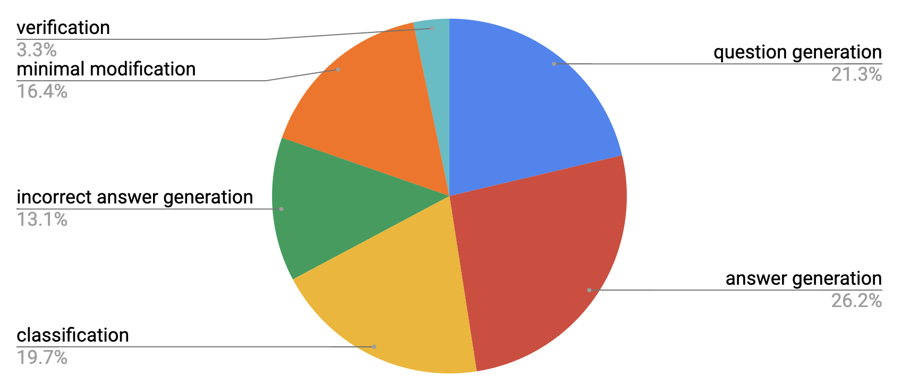
Natural Instructions: Statistics
61 tasks and 160k input/output instances
Notes:
TODO: emphasize that not all tasks in the same category have are actually identical

Slide 44
Natural-Instructions: Example
input instance (paragraph, story, etc.)
Definition
Things to Avoid
Emphasize/Caution
Prompt
Positive Examples:
Negative Examples:
Positive example
Positive example
an output (question, answer, label, etc.)
Input
Output
Input
Output
Reason
Reason
Suggestion
Notes:
Back to the big picture now:
Here is our setup where the inputs to the system are:
An instruction represented based on our schema
Inputs to the model (like a paragraph, etc)
The model is expected to apply a change to the input, based on the given instruction

Slide 45
Natural-Instructions: Example
input instance (paragraph, story, etc.)
Generating “duration” questions task
Definition: In this task, we ask you to write a question that involves “event duration", based on a given sentence. Here, event duration is defined as the understanding of how long events typically last. For example, “brushing teeth”, usually takes few minutes.
Emphasize/Caution: The written questions are not required to have a single correct answer.
an output (question, answer, label, etc.)
Things to Avoid: Don't create questions which have explicit mentions of answers in text. Instead, it has to be implied from what is given. In other words, we want you to use "instinct" or "common sense".
Positive example 1
Input: Sentence: Jack played basketball after school, after which he was very tired.
Output: How long did Jack play basketball?
Reason: The question asks about the duration of an event; therefore it's a temporal event duration question.
…
Notes:
To contextualize it with an an actual example:
- Here is the instructions for the task of …

Slide 46
Natural-Instructions: Example
Text: She chose to make a salad for lunch tomorrow and Sunday.
Generating “duration” questions task
Definition: In this task, we ask you to write a question that involves “event duration", based on a given sentence. Here, event duration is defined as the understanding of how long events typically last. For example, “brushing teeth”, usually takes few minutes.
“how long did it take for her to make a salad?
Emphasize/Caution: The written questions are not required to have a single correct answer.
Things to Avoid: Don't create questions which have explicit mentions of answers in text. Instead, it has to be implied from what is given. In other words, we want you to use "instinct" or "common sense".
Positive example 1
Input: Sentence: Jack played basketball after school, after which he was very tired.
Output: How long did Jack play basketball?
Reason: The question asks about the duration of an event; therefore it's a temporal event duration question.
https://instructions.apps.allenai.org/explore
…
Notes:
For this given input, ….

Slide 47
Encoding Instructions
input instance (paragraph, story, etc.)
Definition
Things to Avoid
Emphasize/Caution
Prompt
Positive Examples:
Negative Examples:
Positive example
Positive example
some output (question, answer, label, etc.)
Input
Output
Input
Output
Reason
Reason
Suggestion
text to text architectures:
BART [Lewis et al. 2019]
GPT3 [Brown et al. 2020]
Notes:
For evaluating this setup, we use text to text architectures . . .

Slide 48
Encoding Instructions
input instance (paragraph, story, etc.)
Definition
Things to Avoid
Emphasize/Caution
Prompt
Positive Examples:
Negative Examples:
Positive example
Positive example
enc(.)
some output (question, answer, label, etc.)
Input
Output
Input
Output
Reason
Reason
Suggestion
text to text architectures:
BART [Lewis et al. 2019]
GPT3 [Brown et al. 2020]
Notes:
Now, to use these architectures, we need a simple encoding function that maps the input instance and instruction into plain text.

Slide 49
“definition: ${def}
things to avoid: ${avoid}
emphasis/caution: ${emphasis}
Positive example1:
input: ${ex_in},
output: ${ex_out},
reason: ${ex_reas}
prompt:${prompt}
input: ${input}
output:”

Slide 50
Experiment: Evaluating GPT3
Does GPT3 understand task instructions?
Instructions improve GPT3's performance! 🎉
A wide margin to be solved 🤔
A task-specific BART scores ~70%
output quality (ROUGE)
0 20 40 60 70
30
prompt
35
prompt + definition
24
44
full instructions
full instructions
- negative ex.
task-specific
models
Notes:
First, we take a look at GPT3’s performance when prompted with our instructions.
(read the plots)
…. which is quite encouraging
Nevertheless, this model is far from perfect.
Just a small BART model trained and evaluated on each task (no generalization) achieves

Slide 51
Exp: Generalization over a Random Split
Can models learn to act w.r.p. instructions?
BART (base) [Lewis et al. 2019]
Randomly split the tasks
12 evaluation tasks
49 supervision tasks
Small models, too, generalize to unseen tasks! 🥳
Do models cheat because of train/eval overlap?
output quality (ROUGE)
0 10 20 30 40
13
no instructions
20
30
prompt
32
prompt + definition
35
full instructions
full instructions
- negative ex.
Notes:
The next experiment studies whether a model would benefit from observing instructions as its supervision.
We can’t fine-tune GPT3 due to its massive size, but we can fine-tune smaller model.
To study this question, we create train / test split for our instructions. …
(read the plots)
Similarly, we see that the addition of instructions help a small show better generalization to unseen tasks.
One concern in this experiment is any potential leakage between the train and evaluation tasks, in case there is any similarity/overlap between them.

Slide 52
Exp: Generalization to Unseen Task Categories
Evaluate on task of a particular category and train on the rest.
Instructions improve generalization to tasks of unseen categories! ✨
output quality (ROUGE)
output quality (ROUGE)
0 10 20
0 10 20
11
no instructions
18
no instructions
6
10
prompt + definition
19
prompt + definition
17
21
19
full instructions
full instructions
full instructions
- negative ex.
full instructions
- negative ex.
eval. on unseen “answer generation” tasks
eval on unseen “question generation” tasks
Notes:
…. This motivates another study where the splits are not random.
But instead between training/evaluation is based on a high-level

Slide 53
Exp: Generalization vs Size of Observed Tasks
How the number of observed tasks affects cross-task generalization?
Generalization to unseen tasks improves with more observed tasks! 🔥
40
30
20
10
output quality
Full Instructions
No Instructions
10 20 30 40 50
# of observed tasks
Notes:
How the number of observed tasks affects cross-task generalization.
We supervised models with various number of observed tasks.
You can see the trends here:
The figure shows that do not get to see task instructions, there is no tangible value in observing more tasks.
In contrast, the generalization of the models that encode instructions improves with observing more tasks.
This is an exciting observation since it suggests that scaling up our dataset to more tasks may lead to stronger instruction-following systems.
--------------
We fix 6 tasks (one from each category) as our evaluation tasks,
and from the remaining tasks we randomly sample 5, 528 15, 37, 55 tasks. Each point in the figure is averaged over 5 random subsampling of the training tasks.
--> more experiments in the paper

Slide 54
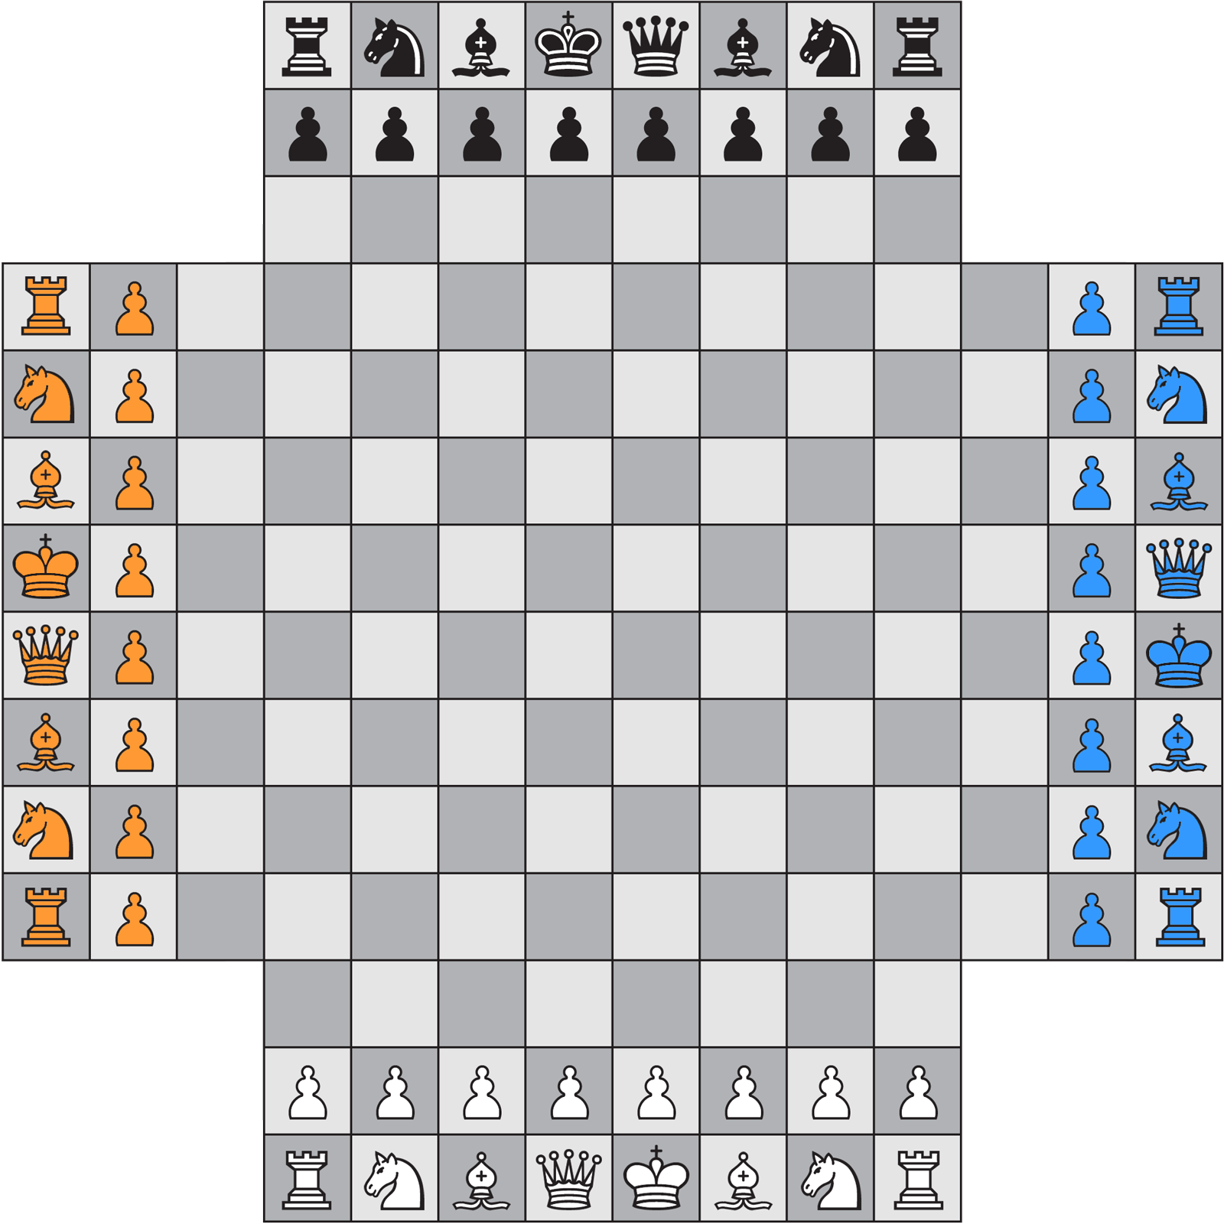
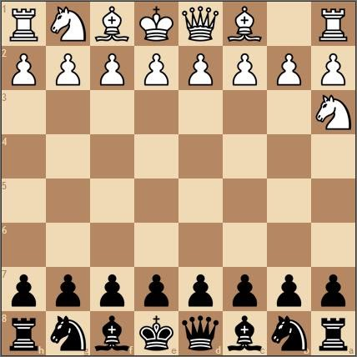
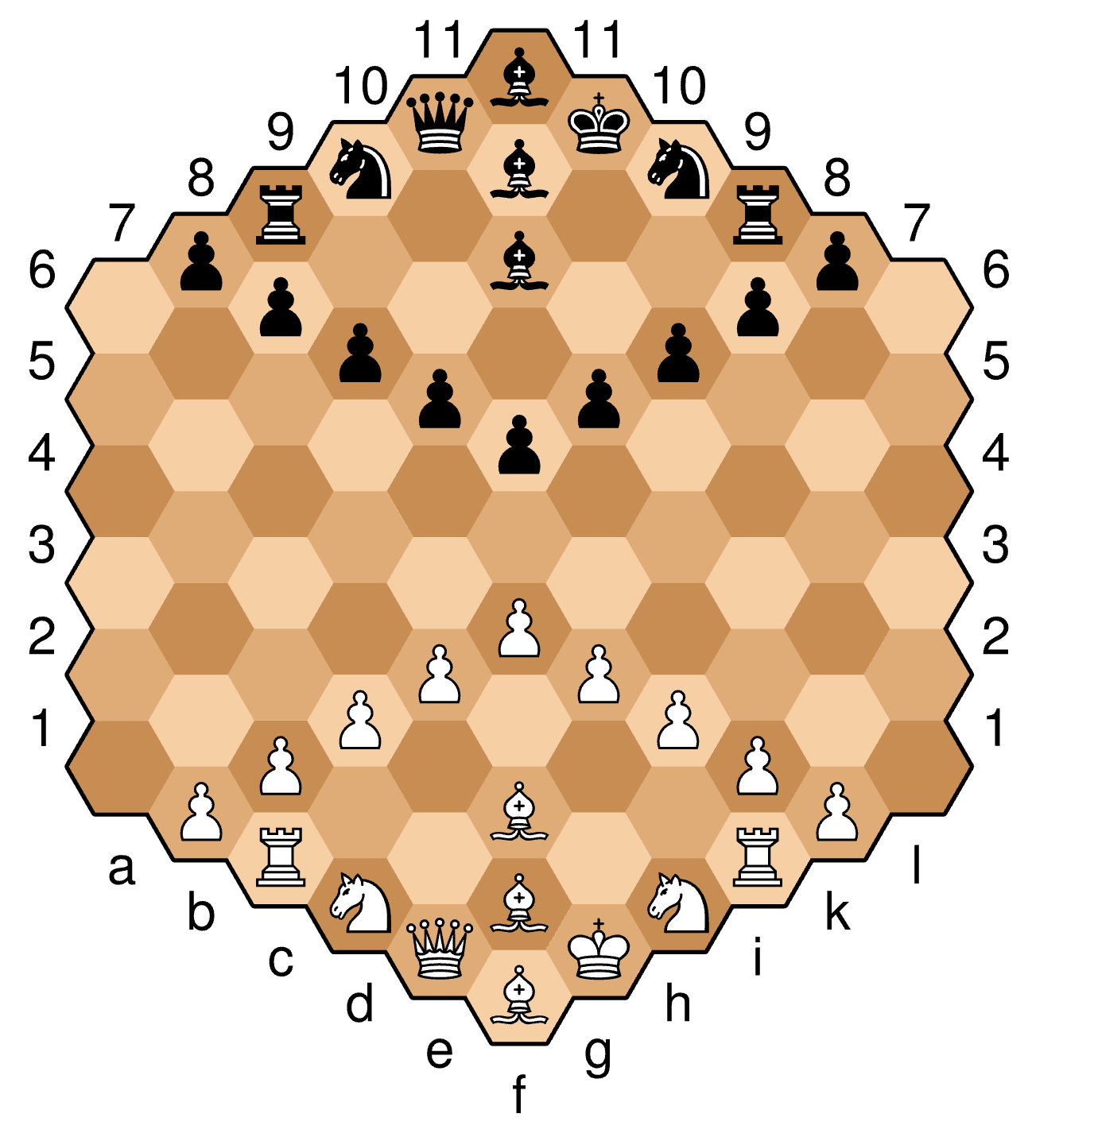
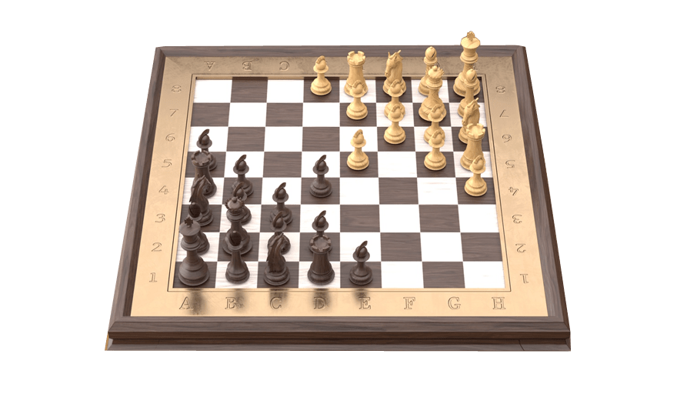
Pandemic Anecdote: Chess
Humans generalize to “unseen” variants of chess.
The standard chess is considered a “solved” problem for AI.
Yet, no system can generalize across chess variants.
Notes:
Let me start with a little bit of anecdote here:
During this pandemic, I got the habit of playing online chess;
And not just the standard chess, but different variants that I was not aware of; various boards; Various number of players, etc.
Interestingly, all these variants, have the same basic principles. So, if you know the standard chess, it is relatively easy to switch between various variants.
Now if you think about state of AI in chess:
Chess is usually considered a ”solved” problem for AI.
Yet, there is no system that can learn about basic principles of chess and seamlessly generalize to an unseen chess variant.
Which goes to show how “narrow” our tasks definitions in AI are.

Slide 55
Lessons
Motivating Hypothesis:
Humans can generalize across tasks; why can’t our models?
Natural language instructions can help models generalize to unseen tasks.
Natural-Instructions: a dataset of many tasks and their crowdsourcing instructions/annotations.
Empirical evidence that:
Instructions help w/ generalization to unseen tasks!
There is notable room to make progress!
http://instructions.apps.allenai.org
Notes:
We introduced Text Modular Networks: a general-purpose framework for solving complex questions.
Based on this conceptual framework, we built ModularQA.
Empirically, ModularQA is competitive with other modular approaches, while providing easy-to-interpret explanations of its reasoning.

Slide 56
Instructions Paradigm
Instructions provide a more general medium to express information, as compared to task examples.
Incorporate high-level knowledge.
Define a new task explicitly in natural language.
Instruction paradigm is a strict generalization of the current instance-only paradigm.
Learning from Instructions
Learning from task-specific input/outputs

Slide 57
Tying the Loose Ends
Currently, we do not focus enough on the “breadth” of our progress.
Obsessed with “depth” (e.g., chasing leaderboards for individual tasks)
The two works presented here:
UnifiedQA: broader range of QA formats
Instruction-following models: broader range of tasks
Depth
Breadth
Notes:
Let me circle back my introduction and remind you about the big picture.
Like I argued, in the current state of NLP field, we do not focus enough “breadth” of our progress,
we’re obsessed with depth (e.g., chasing leaderboards for individual datasets).
The two works that I presented here are different ways of expanding the scope of our systems.
In the first section, I talked about models that can address a broader range of tasks.
In the 2nd section, I introduced a framework to build a single system that generalizes to two different multi-hop datasets.
I would emphasize that these are not just two systems:
Initial steps towards a broader view of machine comprehension system design.

Slide 58
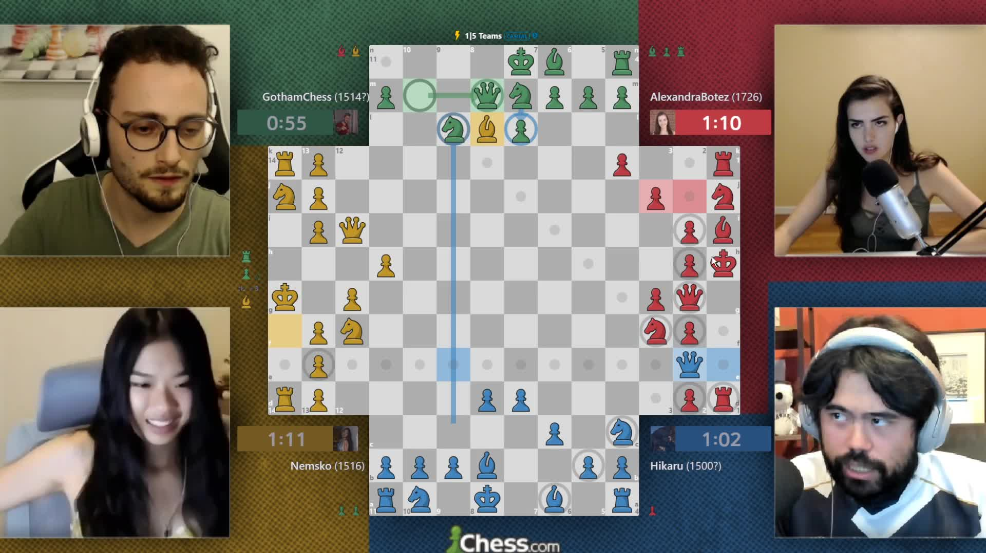
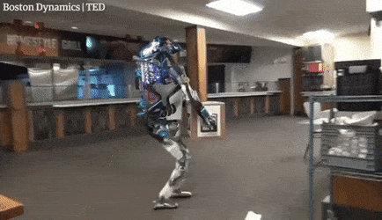
Hurdles Towards “Breadth”
“Depths” is humans’ weakness!
Difficult to master tasks
Good with mixing problems
Computers tend to be the opposite!
Notes:
Now, why making progress towards “breadth” has been difficult?
Part of the reason, in my opinion, is because "depth" is Human's weakness.
it’s difficult for us to master individual problems (say Chess: I’ve been practicing my chess for the past year or so, I still suck),
however, we (humans) are really good at context switching and mixing problems.
This is a screenshot of few famous chess players streaming their 4-person chess.
To play 4-person chess, you just need to know the same rules of the usual 2-player chess; you don’t need to know any other rules, you don’t need additional training.
Humans have no difficulty generalizing from 2-player chess t o 4-player chess, eventhough they have different boards.
Computers have the opposite weakness: they’re good at depth (it’s easy for us to make fantastic Chess players), but it’s difficult to build systems that can do mix-and-match between tasks.
Say, a system that can generalize to other variants of chess, only by knowing 2-player chess.
say, a squad-solving chess player system that can also give you financial advice.
And because we the researchers are humans, by design we’re bad at thinking about what is a good challenge for computers. → something to be careful about.
########
You might have noticed that I did not mention “generalization” throughout the presentation
Here is your text-book definition for “generalization”: ….
But what is “unobserved inputs”? What qualifies for unobserved? (“unobserved” along what axis?)
My beef with our current notions of ”generalization” is that it does not capture the difference between ”depth” and “breadth”.
How can we modify it to account for both depth and breadth?
These are the research questions that I hope we can address in the coming few years.

Slide 59
That’s it!
Notes:
That’s all I had, I appreciate your time and attention.

Slide 60
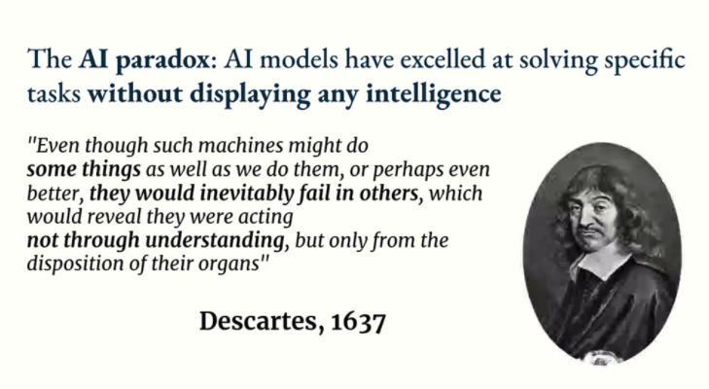

Slide 61
Slide due to Francois Chollet

Slide 62
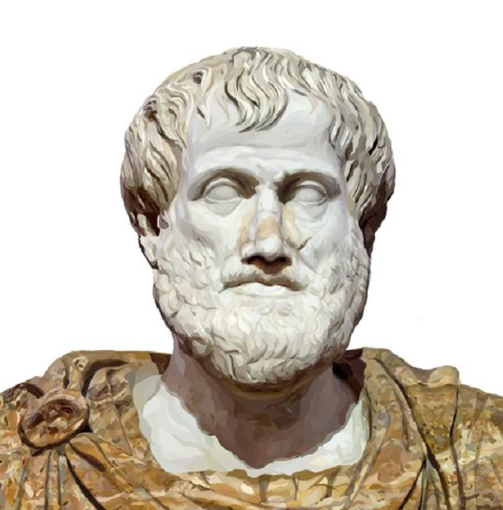
A Challenge Dataset for Implicit Composition
Lived not that long ago!
An average human has no difficulty lifting objects
Did Aristotle Use a Laptop?
Was Aristotle able to carry an object as heavy as a laptop?
StrategyQA [Geva et al. TACL’21]
Notes:
Before I end, let me spotlight a related challenge dataset we recently released challenge for QA.
Obviously, building challenge datasets is important aspect our field today since this way incentivize the field to address harder problems.
in our recent work, we focus on compositional QA where the compositions are “implicit”.
Consider this example: “Did Aristotle have a laptop?”
The answer obviously is a “no”: Because as know Aristotle lived a long time ago, when laptops were not invented.
But what made us reason this way. After all, there is no mention of time in the statement of the question.
I can easily ask many other questions about Aristotle that does not involve time. For example ….
In a nutshell, we know so many attributes about Aristotle: and somehow humans know what attribute is needed to form an appropriate reasoning. But that’s not so trivial for machines.
That’s the challenge defined in the StrategyQA dataset, where the questions involve implicit decompositions.
If you're working on QA and wanna play with a new datasets, please take a look at our work!
##################
And by introducing this challenge, we’re hoping to drive the research towards the models that do not just train on a single dataset, but those that address a broader a range of skills.
Before I end, let me spotlight a related challenge dataset we recently released for QA,.
Let me try to explain the idea here, with several questions from the dataset:
“Did Aristotle have a laptop?”
The answer obviously is a “no”, because as know Aristotle lived a long time ago.
- Average human has no difficulty lifting objects
- ancient Greece had hot summers and mild winters
That’s the challenge defined in the StrategyQA dataset, where the questions involve implicit decompositions.
And by introducing this challenge, we’re hoping to drive the research towards the models that do not just train on a single dataset, but those that address a broader a range of skills.
# I spend quite a bit of my time on evaluation of models, for example by building challenge datasets.
# This is important since this way incentivize the field to address harder problems.

Slide 63
Progress Towards “Breadth”
Humans are bad with “depths”!
Computers are the opposite!
Our progress needs a more refined definition for “generalization”!
“The ability to perform well on previously unobserved inputs is called generalization.” [Deep Learning, Goodfellow et al. , 2015]
Notes:
Now, why making progress towards “breadth” has been difficult?
Part of the reason, in my opinion, is because Humans are bad with depths
it’s difficult for us to master individual problems (say Chess: I’ve been practicing my chess for the past year or so, I still suck),
however, we (humans) are really good at context switching and mixing problems.
This is a screenshot of few famous chess players streaming their 4-person chess.
To play 4-person chess, you just need to know the same rules of the usual 2-player chess; you don’t need to know any other rules, you don’t need additional training.
Humans have no difficulty generalizing from 2-player chess t o 4-player chess, eventhough they have different boards.
Computers have the opposite weakness: they’re good at depth (it’s easy for us to make fantastic Chess players), but it’s difficult to build systems that can do mix-and-match between tasks:
Say, a system that can generalize to other variants of chess, only by knowing 2-player chess.
say, a squad-solving chess player system that can also give you financial advice.
And because we the researchers are humans, by design bad at thinking about what is a good challenge for computers. → something to be careful about.
You might have noticed that I did not mention “generalization” throughout the presentation
Here is your text-book definition for “generalization”: ….
But what is “unobserved inputs”? What qualifies for unobserved? (“unobserved” along what axis?)
My beef with our current notions of ”generalization” is that it does not capture the difference between ”depth” and “breadth”.
How can we modify it to account for both depth and breadth?
These are the research questions that I hope we can address in the coming few years.

Slide 64
Progress Towards “Breadth”
Humans are bad with “depths”!
Computers have the opposite problem!
Need a refined definition for “generalization”!
“The ability to perform well on previously unobserved inputs is called generalization.” [Deep Learning, Goodfellow et al. , 2015]
Notes:
Part of the reason behind this obsessions is because Humans are bad with depths
it’s difficult for us to master individual problems (say Chess: I’ve been practicing my chess for the past year or so, I still suck),
however, we (humans) are really good at context switching and mixing problems.
Computers have the opposite weakness: they’re good at depth (it’s easy for us to make fantastic Chess players), but it’s difficult to build systems that can do mix-and-match between tasks: say, a squad-solving chess player system that can also give you financial advice.
We researchers (as human beings), are by design bad at thinking about what is a good challenge for computers. → something to be careful about.
You might have noticed that I did not mention “generalization” throughout the presentation
Here is your text-book definition for “generalization”: ….
My beef with our current notions of ”generalization” is that it does not capture the difference between ”depth” and “breadth”.
But what is “unobserved inputs”? What qualifies for unobserved? (“unobserved” along what axis?)
How can we modify it to account for both depth and breadth?
These are the research questions that I hope we can address in the coming few years.

Slide 65
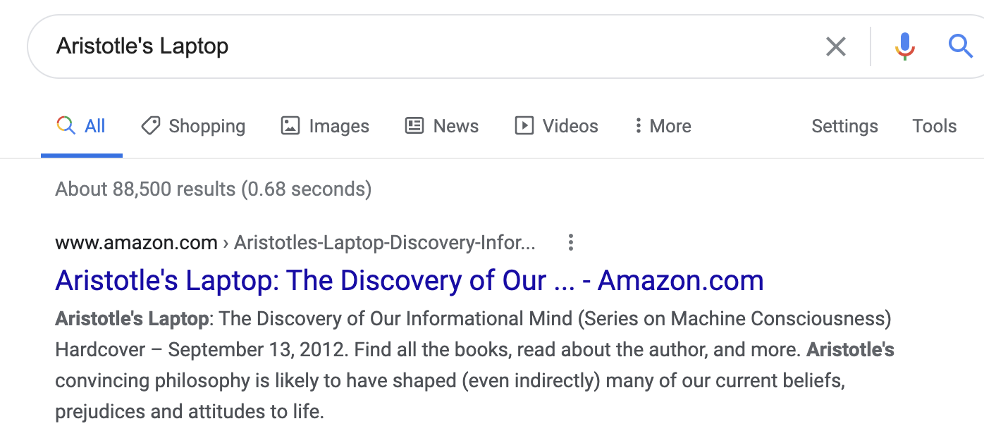
Implicit Composition
Lived a long time ago!
Was a human
Lived not that long ago!
Lived in Greece
Did Aristotle Use a Laptop?
Did Neanderthals know about Aristotle’s ideas?
Did Aristotle have the power to lift an object as heavy as a laptop?
Would Aristotle have preferred a warm coat over a short-sleeved shirt?
StrategyQA [Geva et al. TACL’21]
Notes:
I am going to end by spotlighting a recent challenge dataset we built for QA, where the questions involve implicit decompositions.
Let me try to explain the idea here, with several examples:
“Did Aristotle have a laptop?”
The answer obviously is a “no”, because as know Aristotle lived a long time ago.
“”:
B
That’s the challenge defined in the StrategyQA dataset.
- Average human has no difficulty lifting objects
- ancient Greece had hot summers and mild winters
I spend quite a bit of my time on evaluation of models, for example by building challenge datasets.
This is important since this way incentivize the field to address harder problems.

Slide 66
Better Systems
Continue towards broader scope for QA models
Broadness: how to cover a larger range of “natural” variations of QA?
Reliability: we can we quantify what model [un]certainty?
Faithful Explainability: can we get explanations that are faithful to models’ reasoning?
Efficiency: Can we build small, yet accurate models?
Depth
Breadth
Notes:
… knowing that Google has many applications that are QA-like, I know all of these attributes are of interest for Google.

Slide 67
Big Picture & Look Ahead
Notes:
… very briefly I am going mention my other experiences.

Slide 68
Look Ahead
Notes:
Briefly, about future directions:

Slide 69
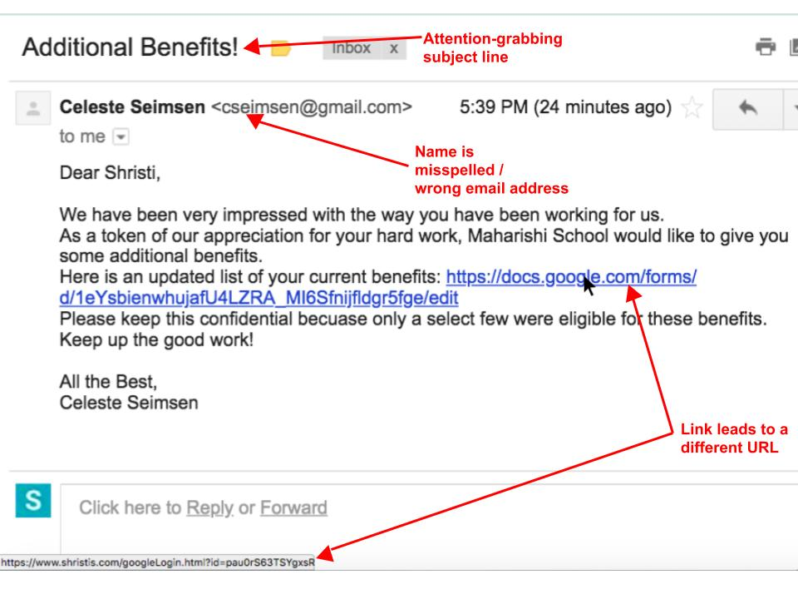
Learning from Instructions
Input-output supervision
instructions
Notes:
The landscape of NLP is dominated by single-input, single-output supervision for fixed tasks.
But now that we have saturated many individual tasks, we should move to higher abstractions of tasks.
One such abstraction that I am interested in is: task descriptions. Can we just “describe” (in plain language) a certain desired behavior?
Benefits:
more flexible that imitating input-output datasets
would save lots of money that typically put into building input/output datasets
There are many tasks that are difficult to be formulated as datasets → outlier behaviors (distribution tail) e.g., someone’s allergy to a certain food.
With all the advances in building stronger language-models (T5, GPT3, etc), I think there is a lot that we can do here.
Such a flexible NLP model design could be quite beneficial for Google.

Slide 70
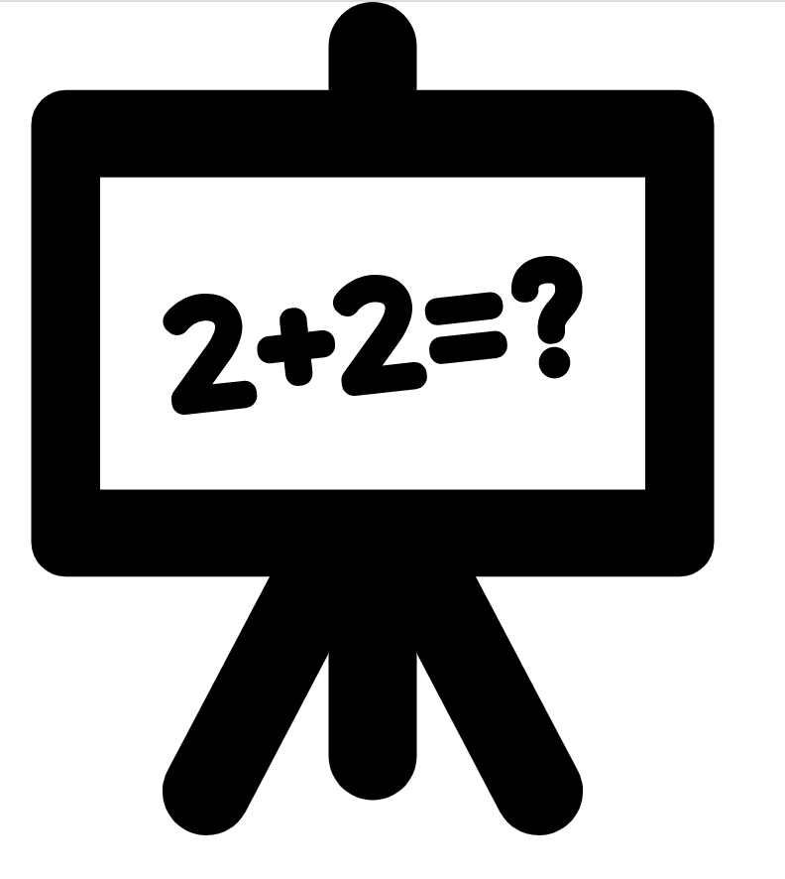


Interactive Semantics
Single-shot evaluation
input problem
evaluation
Learning from interactions
Notes:
The dominant setup in nlp is “single shot” evaluation: given an input instance, a model needs to predict an output on which its accuracy is judged.
People, however, do not communicate in this manner.
Humans interact; there is often back and forth.
This interaction helps humans resolve errors, resolve differences and learn from each other.
I believe we should also move towards such ideas in NLP as well.
I think applications like Google Assistant are very natural testbed for “interactive semantics”.

Slide 71
Demos
https://unifiedqa.apps.allenai.org
https://modularqa-demo.apps.allenai.org

Slide 72
QA datasets
…
OBQA
BoolQ
NarQA
DROP
SQuAD1
SQuAD 2.0
ComQA
…
TREC-8
TREC-9
TREC-2001-2005.
MCTest
RACE
ARC
WinoGrande
2000 2005 2010 2015 2020
Question: “Who was Billy?”
Passage: “Billy was like a king on the school yard. A king without a queen. He was the biggest kid in our grade, so he made all the rules during recess. ... Candidates: (A) The skinny kid (B) A teacher (C) A little kid (D) The big kid
“The big kid”
Notes:
Here is another format you’re familiar with: multiple-choice QA, where the question comes with a bunch of candidates.
(read the question) and the expected answer is one of these candidate answers.

Slide 73
QA datasets
…
OBQA
BoolQ
NarQA
DROP
SQuAD1
SQuAD 2.0
ComQA
…
TREC-8
TREC-9
TREC-2001-2005.
MCTest
RACE
ARC
WinoGrande
2000 2005 2010 2015 2020
Question: “What does a drink from narcissus's spring cause the drinker to do?”
“fall in love with themselves ”
Candidates: Mercury has awakened Echo, who weeps for Narcissus, and states that a drink from Narcissus's spring causes the drinkers to ``Grow dotingly enamored of themselves.'' ...

Slide 74
QA datasets
…
OBQA
BoolQ
NarQA
DROP
SQuAD1
SQuAD 2.0
ComQA
…
TREC-8
TREC-9
TREC-2001-2005.
MCTest
RACE
ARC
WinoGrande
2000 2005 2010 2015 2020
Question: “At what speed did the turbine operate?”
“16,000 rpm”
Candidates: (Nikola_Tesla) On his 50th birthday in 1906, Tesla demonstrated his 200 horsepower (150 kilowatts) 16,000 rpm bladeless turbine. ...

Slide 75
UnifiedQA: Towards an Implementation
Use text-to-text architectures
T5 [Raffal et al, 2020], BART [Lewis et al, 2019], etc.
Train simultaneously on all datasets.
Batches contains the same number of instances from each training set.
Notes:
The key technical requisite that we’re borrowing from the field is text-to-text architectures, such as T5, BART
We train the models on several dataset simultaneously (as opposed to training in a sequential manner).
### To make sure the model is uniformly exposed to all the datasets, we form batches that are expected to contain the same number of instances from each dataset, regardless of its size (sampling probability == inversely proportional to the size of the training data).

Slide 76
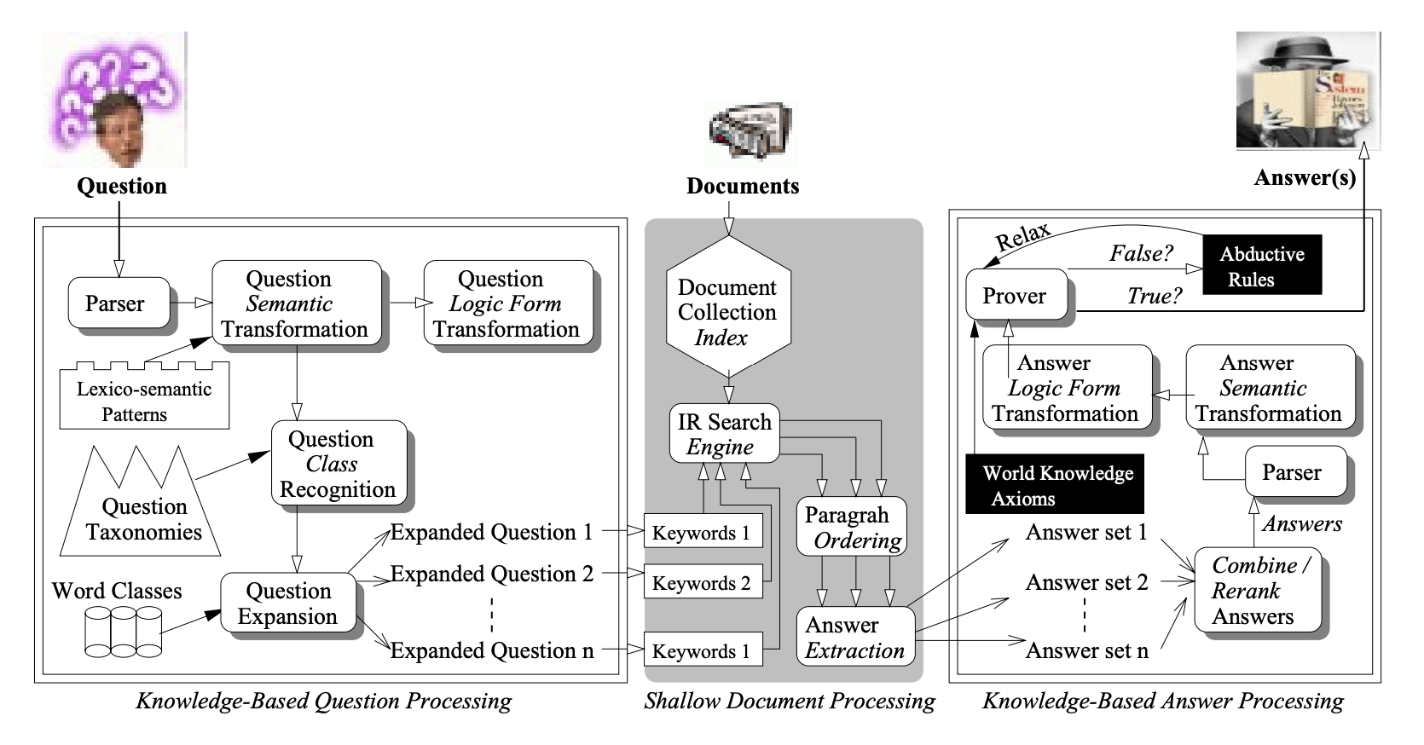
Our progress in QA: the good
More general language representations.
[Harabagiu et al, 2000; others]
Input
Task-specific layer
[Peters et al; Devlin et al; others]
Notes:
With respect to our progress in the field, one point that many of us would probably agree is the generality of the representation techniques today.
On the right you see a picture from QA paper of 20 years ago. You can see sorts of specialized models (parser, question type recognizer, world knowledge axioms, etc) that they had to use internally to build a representation for their QA model.
Now all that you have to do is to download your favorite muppet, feed it the input, and devise a task-specific output for it.

Slide 77
Intuition #2: Unseen Datasets
Does UnifiedQA generalizes well to unseen datasets?
On average, UnifiedQA shows much stronger generalization across a wide range of datasets.
evaluation sets
 | NewsQA | Quoref | DROP | DROP-CS | QASC | CommonsenseQA | NP-BoolQ | BoolQ-CS | Avg
UnifiedQA [EX] | 59 | 65 | 25 | 24 | 55 | 63 | 21 | 13 | 42
UnifiedQA [AB] | 58 | 68 | 31 | 37 | 54 | 59 | 27 | 40 | 48
UnifiedQA [MC] | 48 | 68 | 29 | 37 | 68 | 76 | 3 | 6 | 44
UnifiedQA [YN] | 1 | 2 | 0 | 0 | 15 | 21 | 79 | 79 | 22
UnifiedQA | 59 | 63 | 33 | 40 | 68 | 76 | 81 | 80 | 62
models trained for individual formats
Notes:
We now explore whether UQA generalizes well to other, *unseen* datasets. Here is a table that summarizes the results of experiments where we evaluate various models on datasets that are not observed during training.
Each row is a model.
The first few rows shows T5 models trained for individual formats; (e.g., UQA [EX], built by training the model on only extractive datasets).
The last rows shows UQA (training on multiple formats)
Several observations here:
Single-format experts are better at generalization only when the source and target datasets are very similar (for instance SQuAD and Quoref)
Meanwhile, they do not generalize to unseen datasets of unseen formats;
which kinds of expected, but it goes to show the the importance of feeding a diverse questions, if you want it to function on broad QA.
Overall UnifiedQA shows a pretty generalization compared to the single-format models.
In several cases in fact, UQA shows a better generalization than single-format experts; e.g., DROP.
A point to highlight is that UnifiedQA is trained on multiple-choice questions with 4 candidate answers.
That being said, it works quite well on datasets with more than 4 candidate answers (QASC and CommonsenseQA have has 8 and 5 candidate answers per question, respectively).
On average (last column), UNIFIEDQA shows much stronger generalization across a wide range of datasets.

Slide 78
Experiment: Mixing Pairs of Formats (2)
Is there any value in out-of-format training?
Mixing BoolQ (YesNo) w/ datasets of different formats.
80
70
60
50
X=SQuAD 1 (Extractive)
78.9
76.4
X=SQuAD 1 (Extractive)
66.0
X=NarQA (Abstractive)
64.1
Trained on BoolQ
61.0
53.4
Trained on BoolQ + X
BoolQ
BoolQ-CS
MultiRC (YN subset)
[Clark et al. 19] [Gardner et al. 20] [K et al. 18]
Notes:
Here is another experiment:
(read the plots)
Again, we see similar trends.
Overall, empirically we see that there exists pairs of datasets with different formats that benefit from each other.
This brings us to the question of what happens when you mix multiple datasets of different format?

Slide 79
Experiment: Comparison w/ Dedicated Models
Is UnifiedQA as good as systems dedicated to individual datasets?
UnifiedQA performs almost as good as individual T5 models targeted to each dataset.
evaluation sets
 | SQuAD2 | RACE | BoolQ | NarQA
T5 (SQuAD 2) | 91 | 33 | 12 | 51
T5 (RACE) | 43 | 87 | 7 | 54
T5 (BoolQ) | 4 | 22 | 90 | 0
T5 (NarQA) | 45 | 48 | 47 | 65
UnifiedQA | 90 | 87 | 90 | 65
Notes:
Is UQA as good as dedicated systems trained for individual datasets?
- The BLUE bars belong to UQA (a single system for multiple datasets of different formats).
- The GREEN bars are dataset-specific models; i.e, each bar belongs to each dataset.
The results show that UQA performs almost as good as individual T5 models targeted to each dataset. In some cases UQA performs even better than the single-dataset experts (e.g., on OBQA or NQA).
On average (the bars on the right side) UQA clearly outperforms the ensemble of dataset/format-specific systems.
(show the table)
Here is the subset of the same results in a tabular format.
- each row is a system.
- first few rows are dataset-specific systems.
- And the last row shows UQA.
- You can see that dataset-specific models are good, however, they don't generalize to other formats.
UQA thus offers flexibility across multiple QA formats while compromising almost nothing compared to dataset-specific experts.

Slide 80
Fine-tuning on UnifiedQA
Is there a value in using UnifiedQA as a starting point for fine-tuning?
65
55
45
35
70
66
64
63
55
Fine-tuned on BART
40
Fine-tuned UnifiedQA (based on BART)
OBQA
ARC-chall
CommonsenseQA
[Khot et al. 19] [Clark et al. 18] [Talmor et al. 19]
Notes:
Fine-tuning of pre-trained language models has become the standard paradigm for building datasetspecific stat-of-the-art systems. The question we address here is: when it comes to QA, is there a value in using UNIFIEDQA as a starting point for fine-tuning, as opposed to a vanilla language model that has not seen other QA datasets before?
Here I am showing the results of fine-tine two systems.
We see that fine-tuning on UNIFIEDQA consistently dominates fine-tuning on T5 and BART, respectively.
It also dominates the best previous scores on the datasets. Intuitively, since UNIFIEDQA has seen different formats, it should be positioned to achieve higher scores after a little fine-tuning, compared to fine-tuning on a vanilla T5 or BART model.
This could be especially effective when a user has limited training data for a target QA task This also highlights that the effectiveness of crossformat training is not limited only to T5, but is rather a general trend for text-to-text architectures.

Slide 81
Methodological Issue: Data Leakage
“have you done some studies on overlap across datasets?”
Easy answer:
not much surface-form overlap between the datasets.
Nuanced/ difficult answer:
more data (especially during pre-training) increases the chances of (indirect) leakage.
Notes:
I wanna address a common question that I get these days here;
And that is: (read)
This is a simple question, but surprisingly a tricky one to answer.
If we want to be a bit simplistic, here is the easy answer: On the surface level, there is not much overlap between the datasets, and hence there is no leakage. There is something really unsatisfactory about this answer …
Here is the correct (but the tricky) one: with more more (supervised on unsupervised) observations, the chances of leakage increases.
And this issue is not just particular to UnifiedQA;
Our models have already seen the answers to many of the questions somewhere on the internet, mostly during pre-training.
But the issue is: will the LM or UnifiedQA of today, work on questions of tomorrow; questions that we don’t necessarily know today.
I don't know how to go about studying myself, but I encourage everyone to think about it; we (as a community) need to better methodologies for evaluation of our real progress.

Slide 82
Talk Summary & Statement
Creating format-specific QA models distance us from broad QA.
There is overlap between underlying reasoning abilities of formats.
One can benefit from mixing QA formats.
UnifiedQA: a single QA system working across four common QA formats.
Fine-tuning models pre-trained on UnifiedQA yields SOTA results.
Notes:
- …hence, it is discouraged.
- The good news is that: there is …. [seemingly different]. …
since the reasoning is shared among formats, one can benefit from mixing different QA formats.
- We build based on these intuitions to create a model

Slide 83


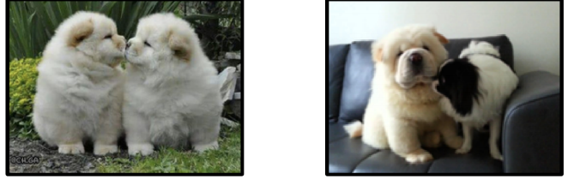

Characterizing models’ decision boundaries [Gardner et al. EMNLP-Findings’20]
Models of Language Problems
Measuring Our Progress
KMKKTCH. EMNLP-Findings’20
KCRUR. NAACL’18
PKR. NAACL’15
GKSKRB. TACL’21
ZKQR. EMNLP’19
KCRUR. NAACL’18
three
differently
Analyses
Two similarly-colored and similarly-posed chow dogs are face to face in one image.
cats
G et al. EMNLP-Findings’20 KKS. EMNLP’20
Notes:
Another chunk of my time is spent on analyzing models,
Whether they do what they’re supposed to do,
What are the unintended behaviors encoded in them
To highlight an example: In a recent work, we advocated for “contrast sets” as a practical way to measure models’ robustness to minor changes at the decision boundaries.

Slide 84
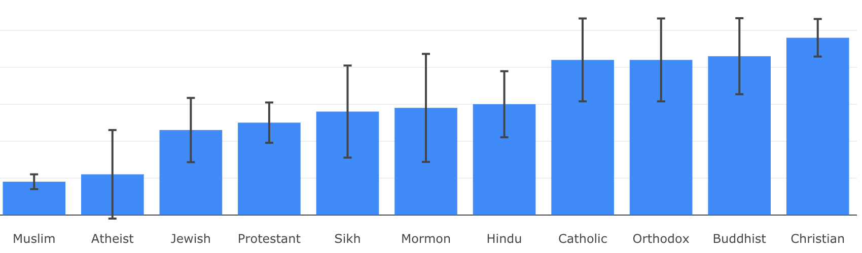

Social Biases in QA Models [Li et al. EMNLP-Findings’20]
Models of Language Problems
Measuring Our Progress
KMKKTCH. EMNLP-Findings’20
KCRUR. NAACL’18
PKR. NAACL’15
GKSKRB. TACL’21
ZKQR. EMNLP’19
KCRUR. NAACL’18
Analyses
NLP+Society
G et al. EMNLP-Findings’20 KKS. EMNLP’20
LKKSS. EMNLP-Findings’20 CKWCR. NAACL’19
Association of ethylic/religious groups with negative stereotypes
Notes:
Last but not least, we build models for problems that are more directly connected to societies.
Along this mindset, I have worked on problems related to social biases encoded in models

Slide 85
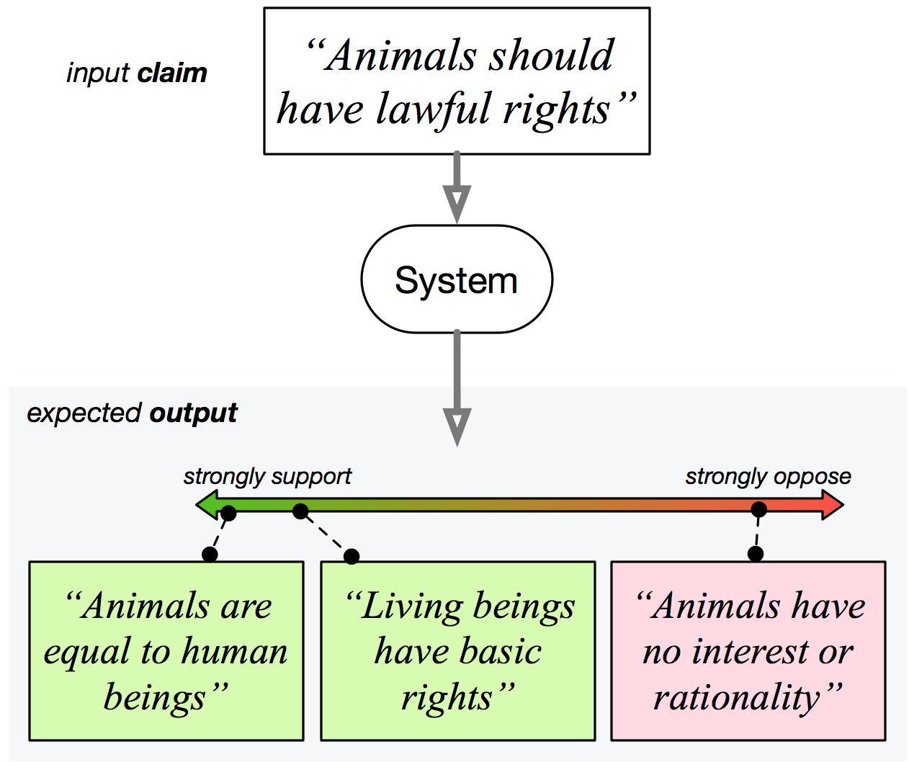
Diverse Perspective Discovery [Chen et al. NAACL’19]
Models of Language Problems
Measuring Our Progress
KMKKTCH. EMNLP-Findings’20
KCRUR. NAACL’18
PKR. NAACL’15
GKSKRB. TACL’21
ZKQR. EMNLP’19
KCRUR. NAACL’18
Analyses
NLP+Society
G et al. EMNLP-Findings’20 KKS. EMNLP’20
LKKSS. EMNLP-Findings’20 CKWCR. NAACL’19
Diverse perspectives to address the given claim.
Notes:
I have also dabbled in the problem domain of “information pollution”, where one needs to tackle issues on: discovery of perspectives, claim provenance, claim trustworthiness, etc. Very crucial problems for the age of “information abundance”.
# Another instance that I remain passionate about is the problem domain of “information pollution”, where one needs to tackle issues on: discovery of perspectives, claim provenance, claim trustworthiness, etc. Very crucial problems for the age of “information abundance”.

Slide 86
The Instruction Paradigm: Challenges
Lack of natural and diverse benchmarks for learning from Instructions.
Few prior works, but they are limited!
No standard schema to represent instructions.
Unclear how to represent “instructions”!
Model response to Instructions has been poor.
Instructions are hard to learn!

Slide 87



Prior Works
Diversity of tasks
Weller et. al (2020):
Defined descriptions as common questions and built the ZEST dataset.
Crowdsourced question-like instructions→ Limited complexity
Weller et al.
where we want to be!
Efrat & Levy (2020):
Proposed the Turking Test: asking models to follow natural language instructions
Aims to address all crowdsourcing instructions at once
→ A very difficult task follow
Limited scope of study
→ Studied only 3 datasets
Efrat et al.
Naturalness of the instructions

Slide 88
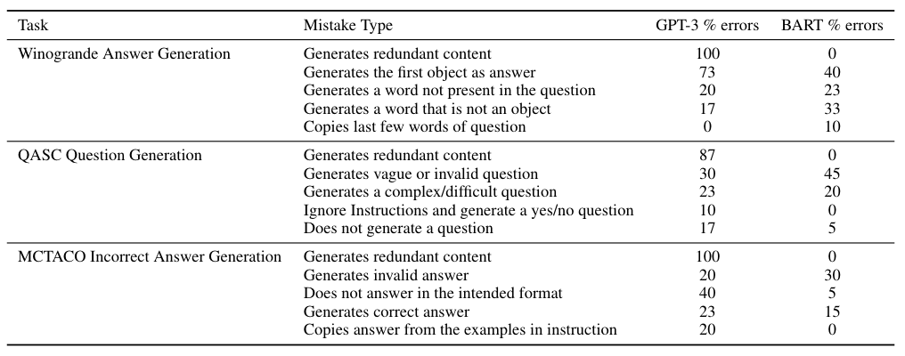
Error Analysis
GPT-3:
Often fails to follow
instruction without
any example.
Too Innovative.
Redundant content
Generation.
BART:
Too Imitative.
Provides more control,
but fails to generate
proper output.
Can we strike a good balance between imitation and innovation?
Notes:
FYI: add pointers/arrows/boxes to walk them through the important numbers.

Slide 89
Design Principles
Natural human-readable instructions.
Diversity.
Positive Examples and Explanation.
Negative instructions.
Instructions regarding what not to do.
E.g.
The generated answers should not belong to the question span.

Slide 90
Summary
Motivating Hypothesis: Instructions help in building models that generalize to unseen tasks .
To study whether language models follow instructions, we proposed an Instruction Schema, collected crowdsourcing instructions, annotations and curated them to build the NATURAL-INSTRUCTIONS dataset.
Performed Fewshot Learning and Generalization Experiments and found out that Instructions improve generalization.
GPT-3: Too innovative, BART: Too Imitative. Balance between them is what we need.
We hope this work will bring more attention to building stronger models that can generalize to a wider range of tasks.

Slide 91

Motivation
Example1: We have used Dataset-X to build a model for basic numerical reasoning (addition and subtraction).
Now, we want a model that can also support “multiplication”.
Shall I crowdsource and create a new dataset everytime?
Example 2: We have used Dataset-Y to build a model for “event” extraction.
Now, our WallStreet firm wants the model to extract all the “events” that refer to company mergers.
Shall we crowdsource another dataset to annotate “merger” events?
It’s unlikely that we will have data samples that cover all aspects of natural language
Learn from “instructions”, just like humans do for many problems

Slide 92


Goal of Our Work:
Can we enable NLP models to appropriately respond to instructional prompts?
Find the common words of these two sentences:
<sent1>, <sent2>
Language Models
Select one of the sentences in the list, that is similar to <sent1>
<list of sentences>
Output: Model Generated Text
Create a Question and Answer pair for me involving language and numerical reasoning (addition)
Input: Instructional Prompts

Slide 93
The Instruction Paradigm: Advantages
Flexibility: It allows to define a potentially-new task explicitly in natural language.
Where does this instruction paradigm stand?
It subsumes the typical paradigm of learning from task-specific input/output pairs (e.g., mapping sentences to their sentiment.)
Any task we currently solve in NLP can be expressed as “instructions”.
Learning from Instructions
Learning from task-specific input/outputs

Slide 94
The Instruction Paradigm: Challenges
Lack of natural and diverse benchmarks for learning from Instructions.
Few prior works, but they are limited!
No standard schema to represent instructions.
Unclear how to represent “instructions”!
Model response to Instructions has been poor.
Instructions are hard to learn!

Slide 95
Prior Works
Weller et. al (2020):
Defined descriptions as common questions and built the ZEST dataset.
Question format and crowdsourcing → Limited complexity
Diversity of tasks
Weller et al.
where we want to be!
Efrat et. al (2020):
Proposed the Turking Test: asking models to follow natural language instructions
Aims to address all crowdsourcing instructions at once
→ A very difficult task follow
Limited scope of study
→ Studied only 3 datasets
Clark et. al (2020):
Showed that model follows “rules” expressed in natural language.
Need to incorporate Instructions beyond rules
Efrat et al
naturalness of the descriptions

Slide 96
Talk Outline
Build a Benchmark to Learn from Instructions:
Reuse crowdsourcing datasets and their instructions.
Analysis on the Collected Data So Far
Quantitative and qualitative analysis
Assessment of Current Models:
Explore how well the current SOTA models generalize across different instructions.
Stretch Goals:
Explore external applications of models that can follow instructions.

Slide 97
Talk Outline
Build a Benchmark to Learn from Instructions:
Reuse crowdsourcing datasets and their instructions.
Analysis on the Collected Data So Far
Quantitative and qualitative analysis
Assessment of Current Models:
Explore how well the current SOTA models generalize across different instructions.
Stretch Goals:
Explore external applications of models that can follow instructions.

Slide 98

Building a Benchmark for “Instructions”
instructions
A typical data construction pipeline
Input
Output
A typical paradigm for learning the mapping from inputs to outputs (e.g., training a sentiment analysis model).
Input
Output
instructions
Our paradigm for learning to map inputs & instructions to their outputs
Input
Output

Slide 99
Build a Benchmark to Learn from Instructions (...)
Crowdsourcing Instructions for Dataset D1
Turkers Create Datasets
Make Models Learn
Input
?
Output
Task of Learning from Instructions
Machines Create Datasets
Focus of this Proposal
Our Approach

Slide 100
Building a Benchmark for “Instructions”
Step 1: Collection of crowdsourced data (and their templates) for a large number (hopefully, >=50) of datasets.
This would involve the intermediate annotations for datasets w/ multiple crowdsourcing steps.
Step 2: Conversion to a structured format
Splitting each dataset (and templates) into sub-tasks, where each sub-task represents one step of data creation process.

Slide 101
Build a Benchmark to Learn from Instructions (...)
Compiled 6 datasets:
Quoref
DROP
CosmosQA
MCTACO
Winogrande
QASC
How to come up with a careful, flexible and high-coverage schema for “instructions”?
Proposed a schema that with a variety of fields.

Slide 102
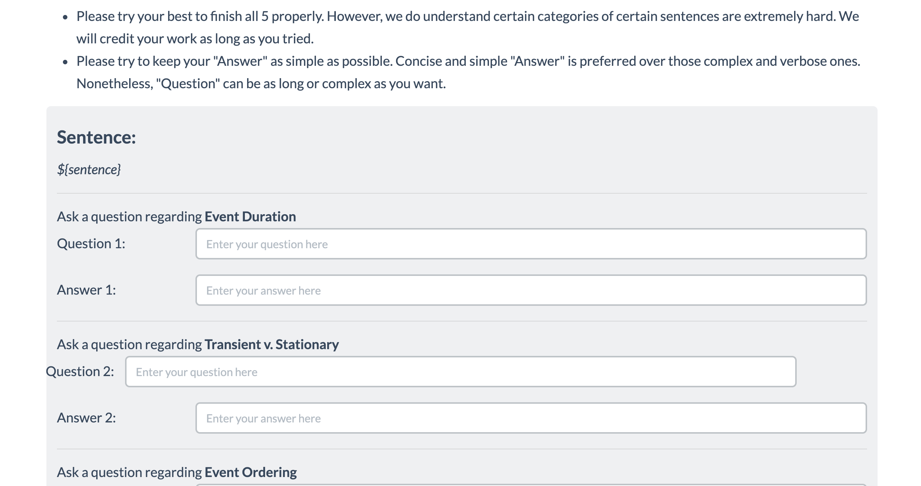
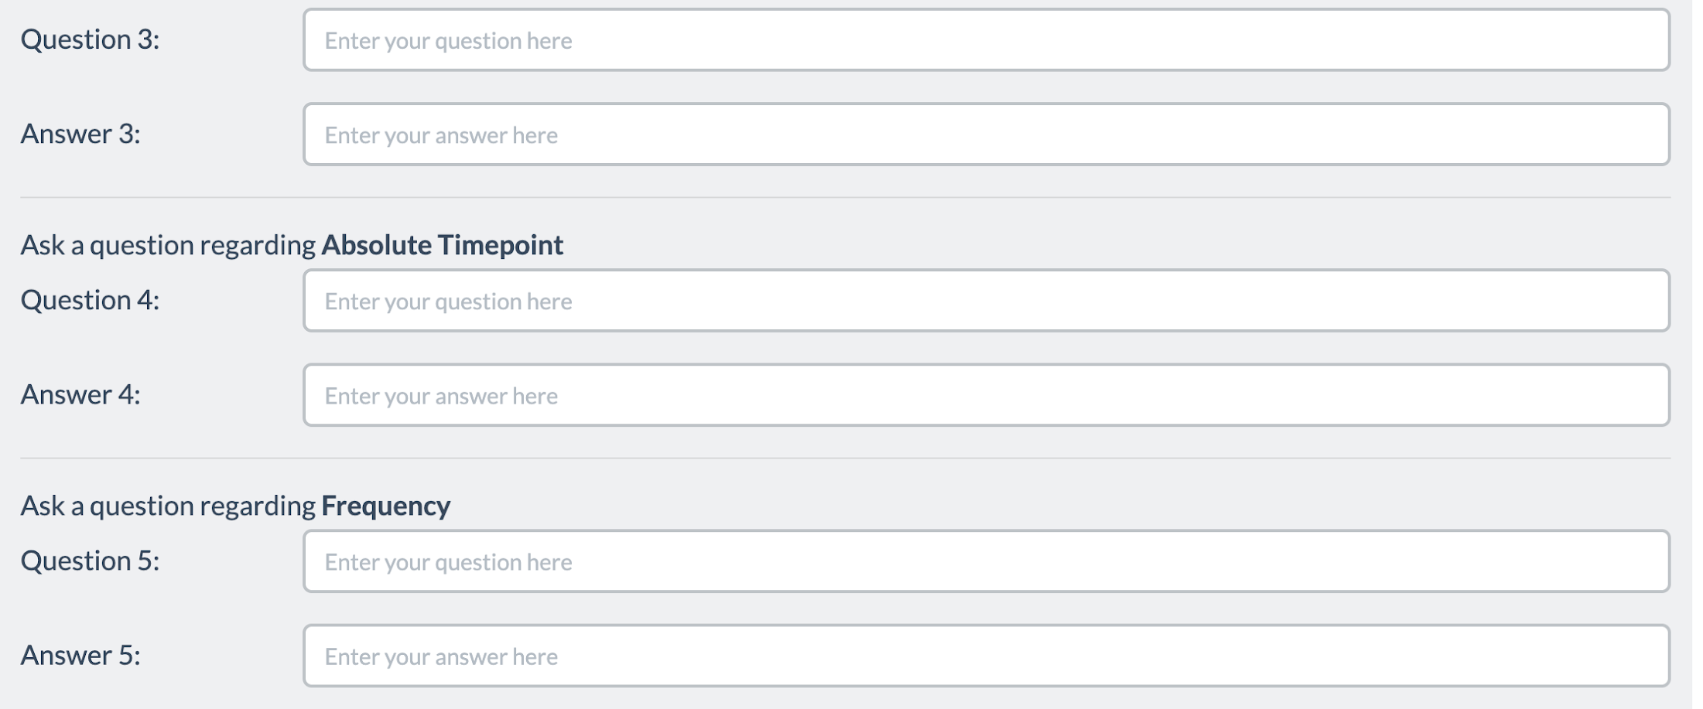
Splitting Templates into “Sub-task”
Split each template in to sub-tasks
Subtask1
Each sub-task represents one step of data creation process.
Input of each sub-task is either external input like passages or output of some other sub-task.
The output is purely collected from crowdworker annotation.
Subtask2
Subtask3
Subtask4
Subtask5

Slide 103
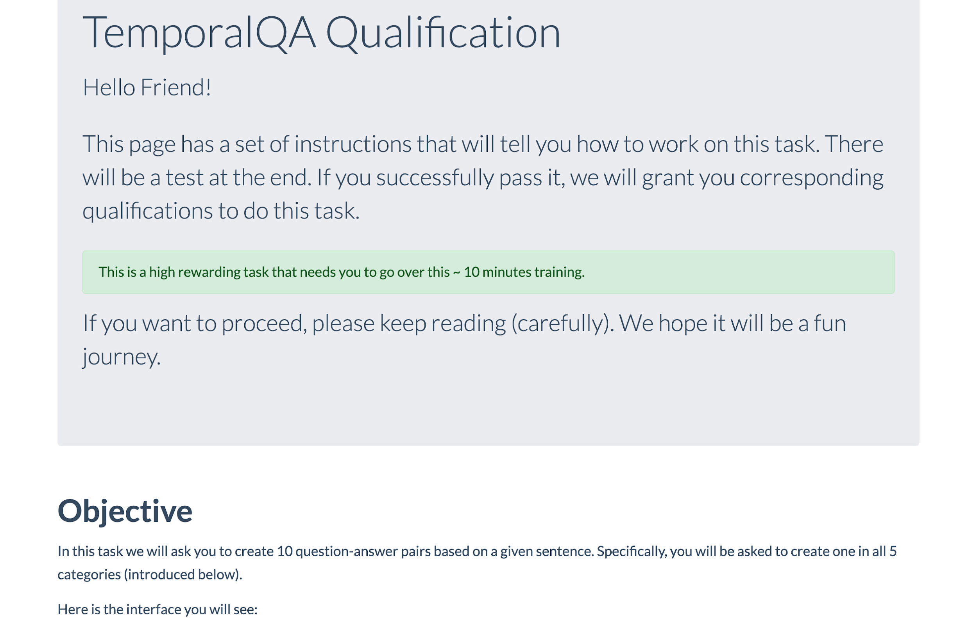
Schema Definition (1)
Sub-task Instructions:
Title
Definition
“Don’t” instructions
Emphasize/Caution
Examples:
Positive example
Negative example
Input
Output
Input
Output
Reason
Reason
Suggestion
# of examples for sub-task
Input/outputs:
Prompt message
input
output
# of sub-task instances
# of sub-tasks

Slide 104
Schema Definition (1)
Sub-task Instructions:
Title
Definition
“Don’t” instructions
Emphasize/Caution
Examples:
Positive example
Negative example
Input
Output
Input
Output
Reason
Reason
Suggestion
# of examples for sub-task
Input/outputs:
Prompt message
input
output
# of sub-task instances
# of sub-tasks

Slide 105
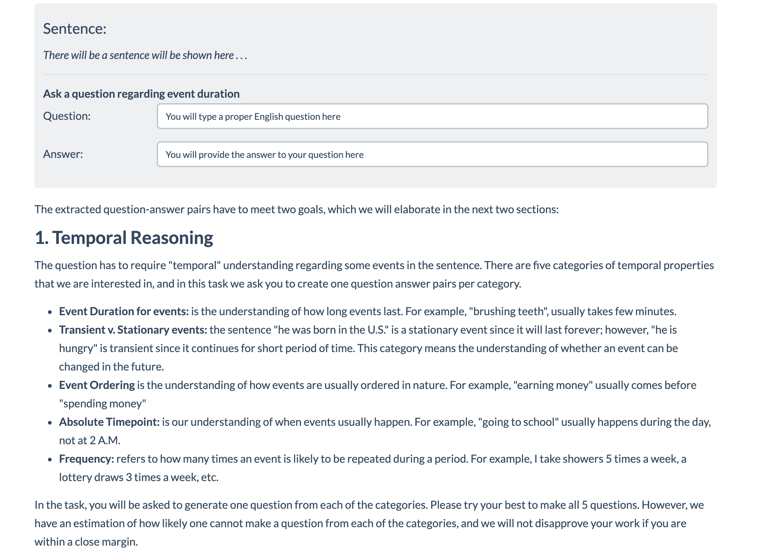
Schema Definition (2)
Sub-task Instructions:
Title
Definition
“Don’t” instructions
Emphasize/Caution
Examples:
Positive example
Negative example
Input
Output
Input
Output
Reason
Reason
Suggestion
# of examples for sub-task
Input/outputs:
Prompt message
input
output
# of sub-task instances
# of sub-tasks

Slide 106
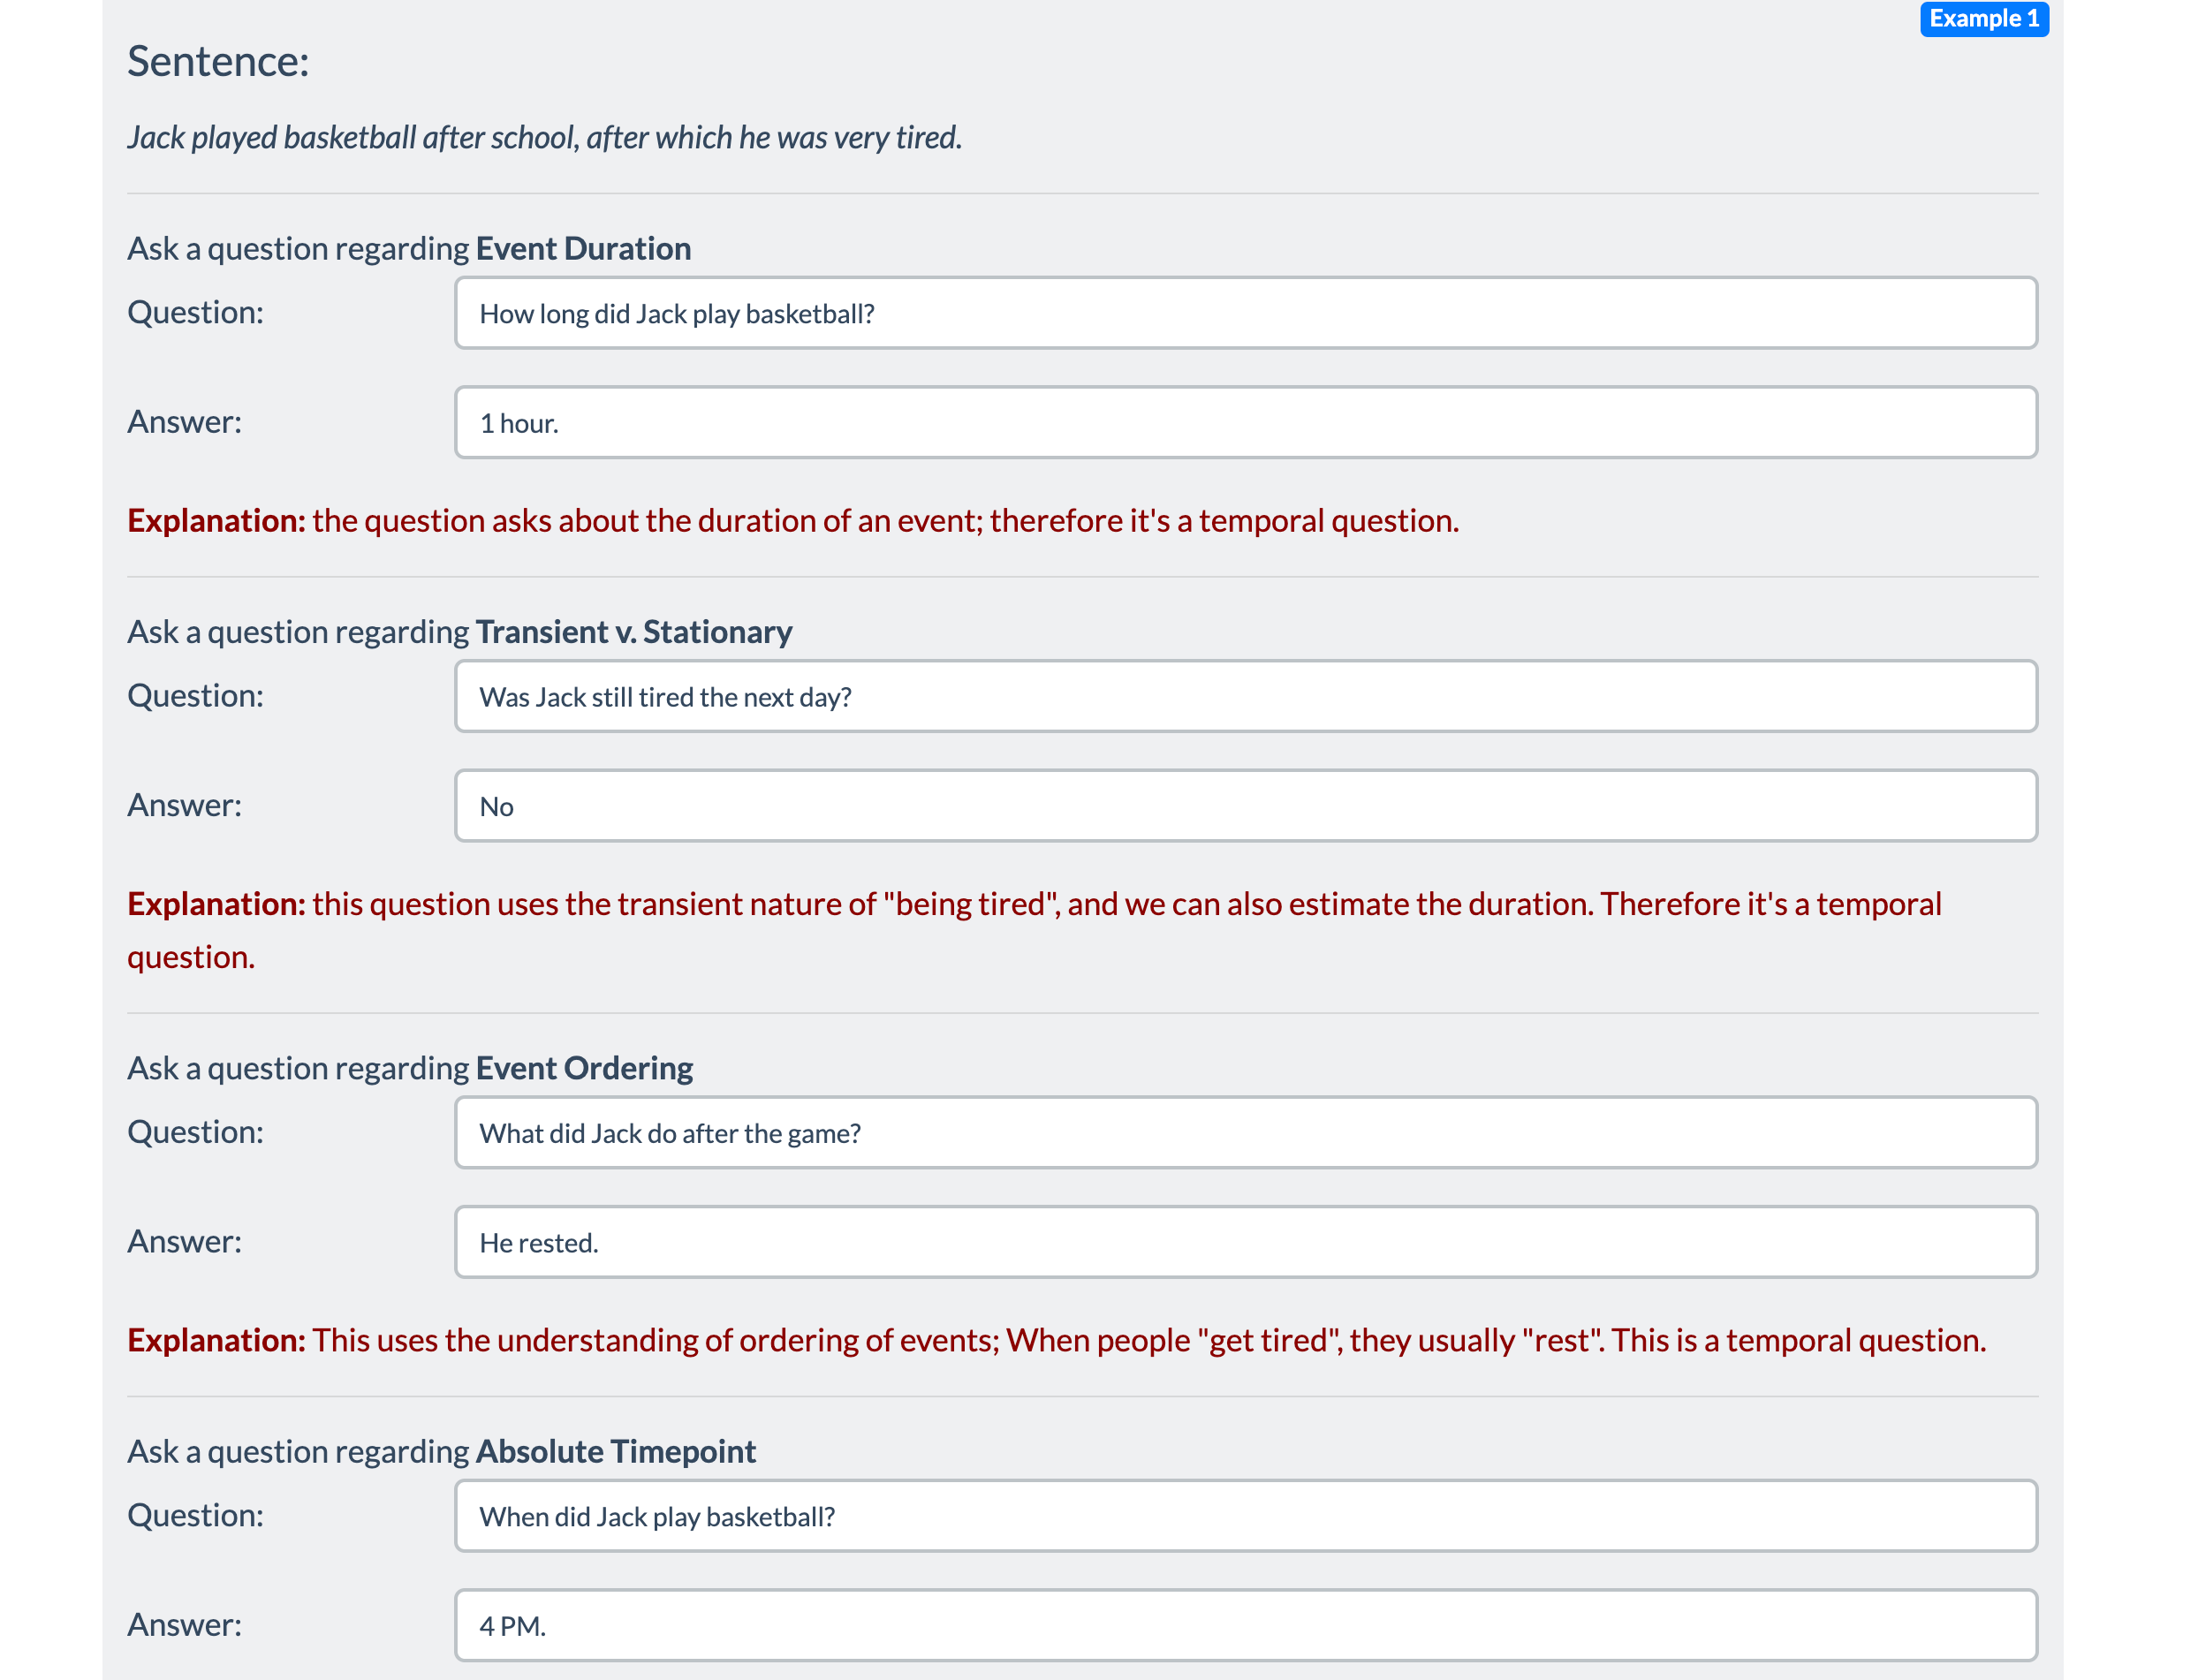
Schema Definition (3)
Sub-task Instructions:
Title
Definition
“Don’t” instructions
Emphasize/Caution
Examples:
Positive example
Negative example
Input
Output
Input
Output
Reason
Reason
Suggestion
# of examples for sub-task
Input/outputs:
Prompt message
input
output
# of sub-task instances
# of sub-tasks

Slide 107
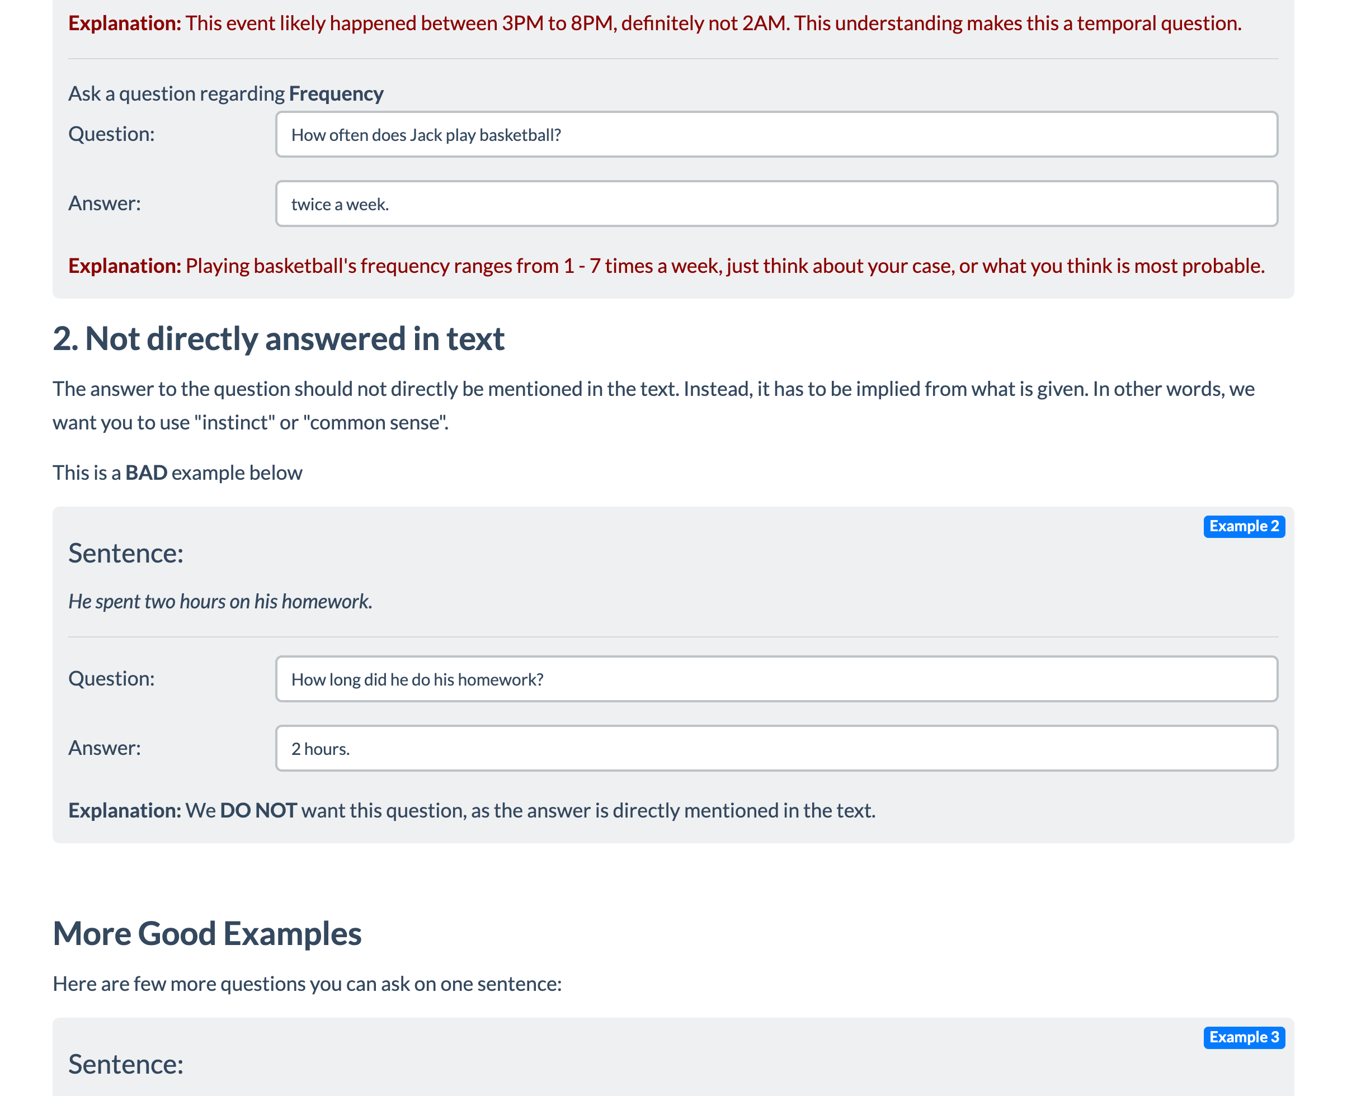
Schema Definition (4)
Sub-task Instructions:
Title
Definition
“Don’t” instructions
Emphasize/Caution
Examples:
Positive example
Negative example
Input
Output
Input
Output
Reason
Reason
Suggestion
# of examples for sub-task
Input/outputs:
Prompt message
input
output
# of sub-task instances
# of sub-tasks

Slide 108
Schema Definition (5)
Sub-task Instructions:
Title
Definition
“Don’t” instructions
Emphasize/Caution
Examples:
Positive example
Negative example
Input
Output
Input
Output
Reason
Reason
Suggestion
# of examples for sub-task
Input/outputs:
Prompt message
input
output
# of sub-task instances
# of sub-tasks

Slide 109
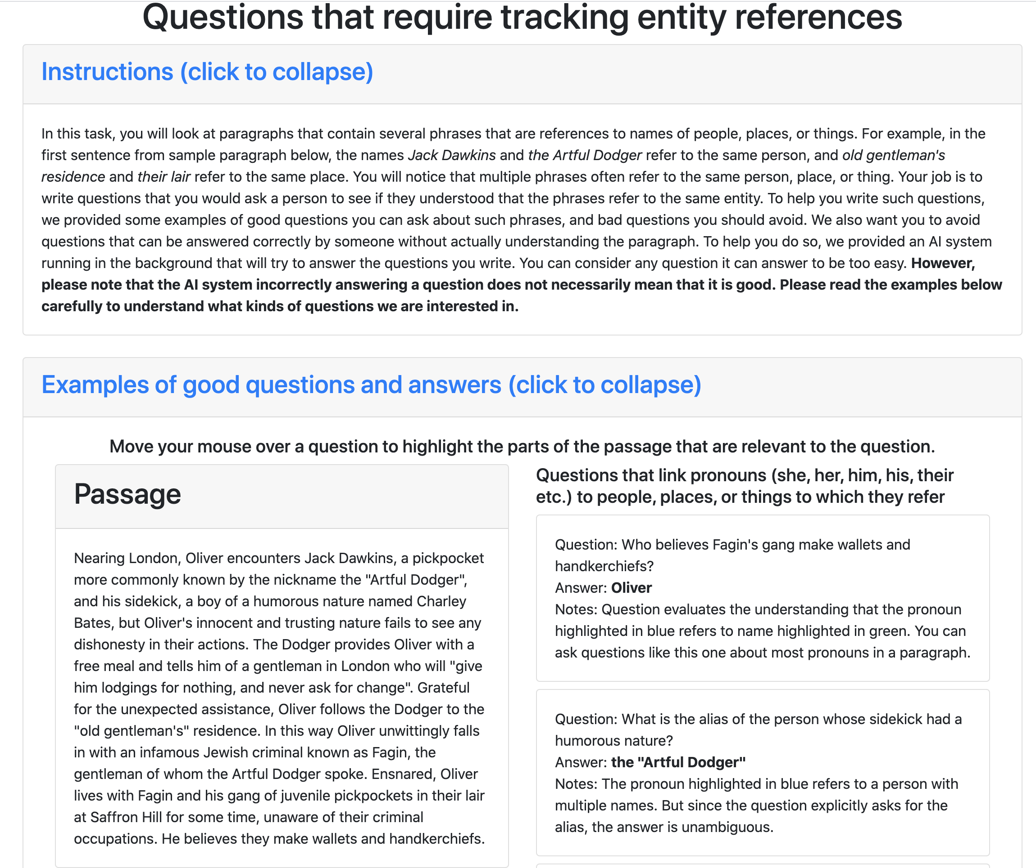
Schema Definition (6)
Sub-task Instructions:
Title
Definition
“Don’t” instructions
Emphasize/Caution
Examples:
Positive example
Negative example
Input
Output
Input
Output
Reason
Reason
Suggestion
# of examples for sub-task
Input/outputs:
Prompt message
input
output
# of sub-task instances
# of sub-tasks

Slide 110
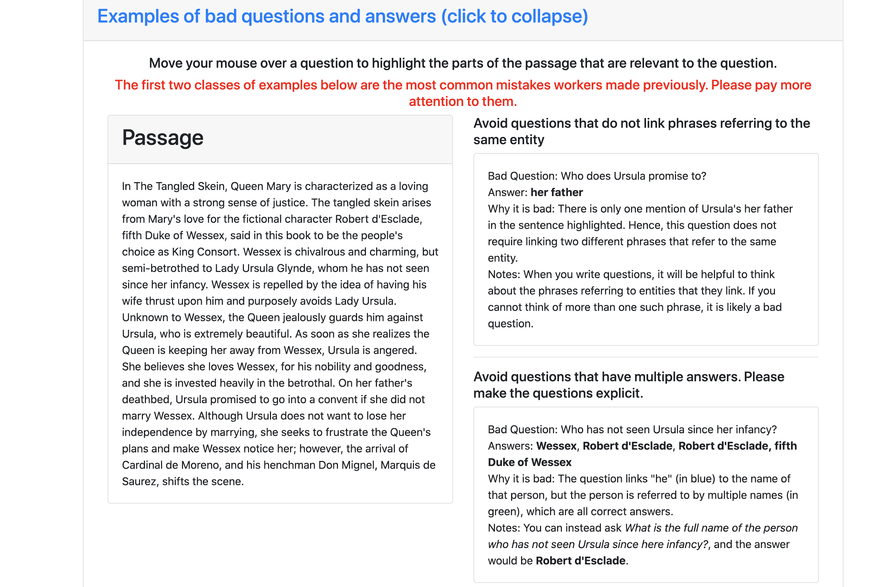
Schema Definition (7)
Sub-task Instructions:
Title
Definition
“Don’t” instructions
Emphasize/Caution
Examples:
Positive example
Negative example
Input
Output
Input
Output
Reason
Reason
Suggestion
# of examples for sub-task
Input/outputs:
Prompt message
input
output
# of sub-task instances
# of sub-tasks

Slide 111
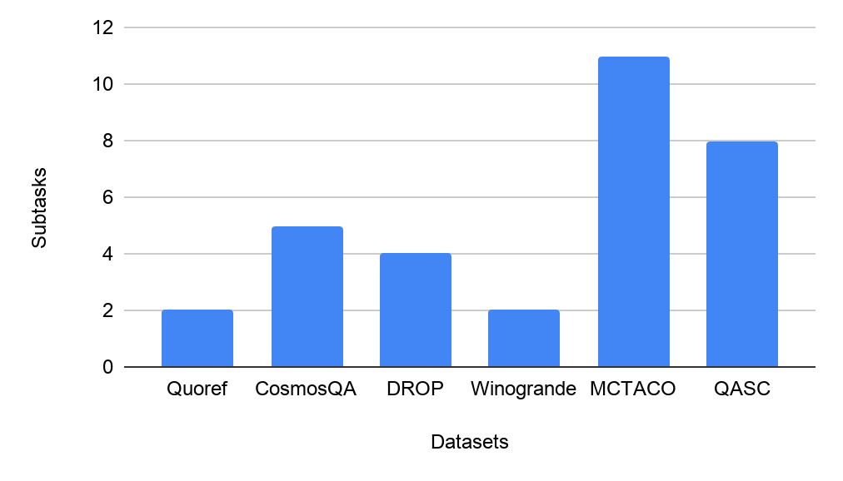
Number of Subtasks
QASC and MCTACO has relatively higher number of subtasks than the rest of the dataset.
Number of subtasks (27) is way higher than the the number of datasets (6).

Slide 112
Statistics of Instruction Set
Total number of instances: 331k
Dataset | sub-task id | # of instances
Quoref | 1 | 21,817
Quoref | 2 | 24,354
MCTACO | 1 | 629
MCTACO | 2 | 629
MCTACO | 3 | 629
MCTACO | 4 | 629
MCTACO | 5 | 629
MCTACO | 6 | 2,400
MCTACO | 7 | 2,400
MCTACO | 8 | 2,400
MCTACO | 9 | 2,400
MCTACO | 10 | 2,400
MCTACO | 11 | 2,400
Dataset | sub-task id | # of instances
DROP | 1 | 86,945
CosmosQA | 1 | 22,722
CosmosQA | 2 | 35,231
CosmosQA | 3 | 35,231
CosmosQA | 4 | 975
CosmosQA | 5 | 975
Winogrande | 1 | 43,932
Winogrande | 2 | ?
QASC | 1 | 7,653
QASC | 2 | 7,653
QASC | 3 | 7,653
QASC | 4 | 7,653
QASC | 5 | 7,653
QASC | 6 | 7,653

Slide 113
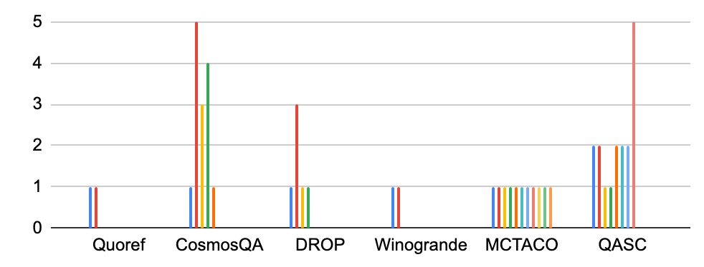
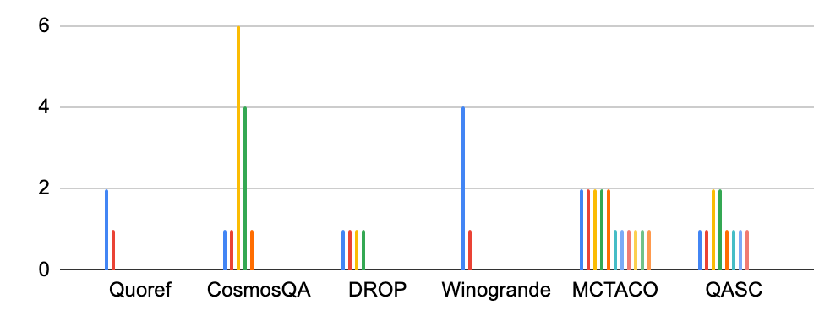
Input/Output Dimensions at each Subtask
distribution of input dimensions
Input Dimension:1
Output Dimension:2
distribution of output dimensions
CosmosQA and QASC have relatively higher dimensional instances, whereas Quoref and MCTACO have relatively lower dimensional instances.

Slide 114
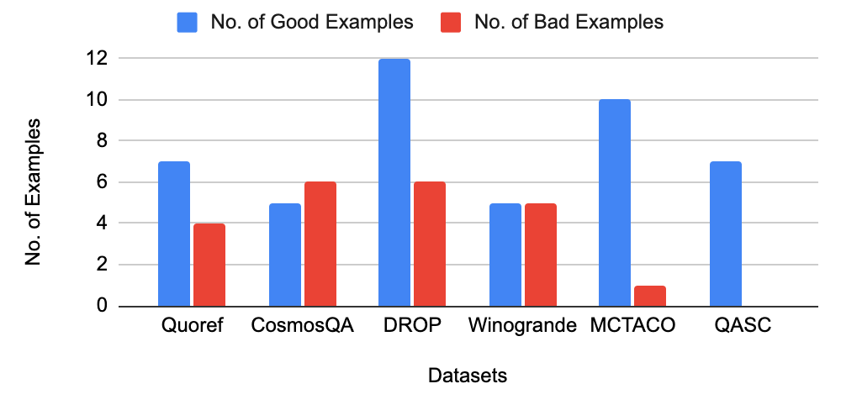
Number of Good/Bad Examples
DROP Instruction consists of relatively higher number of examples than the rest.
Only in Winogrande, no. of good examples provided is same as that of the bad examples.
QASC Instruction does not contain bad examples.

Slide 115
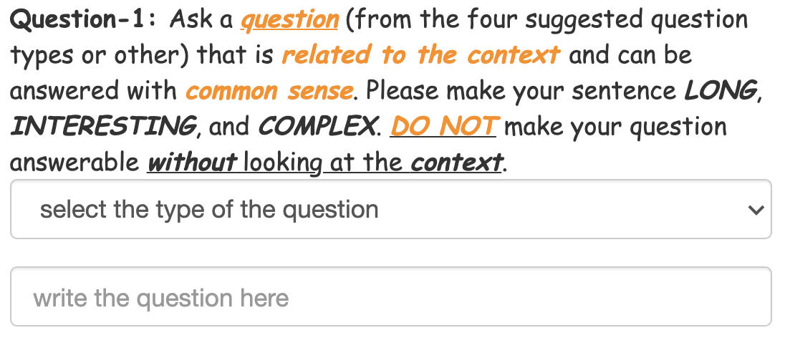
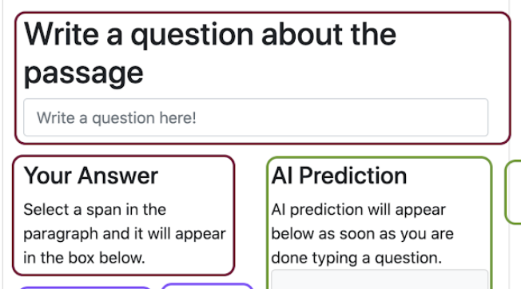
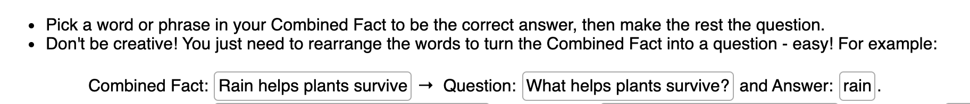
Task Specification [Dis]Similarity
Subtasks with similar objective, however the task specifications are different.
CosmosQA
Quoref
QASC

Slide 116
Topical Analysis
Even datasets with overlapping reasoning skills can have different topical distribution.
Reasoning Skill | Datasets | Topic
Coreference Resolution | Quoref, Winogrande | Quoref uses Wikipedia pages about English movies, art and architecture, geography, history, and music, whereas Winogrande uses wikihow which are very different.
Sentence Composition | DROP, QASC | QASC uses Grade school level science facts from WorldTree corpus and ck12, in contrast to the topic of source corpora in DROP.
Numerical Reasoning | DROP, MCTACO | DROP has passages from history and sports from wikipedia whereas MCTACO is based on randomly selected sentences from a diverse range of topics (news, travel guides, fiction stories etc.)
Commonsense Reasoning | CosmosQA, Quoref, MCTACO, Winogrande | CosmosQA is based on a diverse collection of everyday situations from a corpus of personal narratives and the Spinn3r Blog Dataset. Topics of Quoref, Winogrande and MCTACO are very different.

Slide 117
Analysis of Reasoning Classes
We annotate the dataset with 7 reasoning categories:
Reasoning Class | Datasets Considered
Coref. Resolution | Quoref, Winogrande
Commonsense Reasoning | CosmosQA, Quoref, MCTACO, Winogrande
Numerical Reasoning | DROP, MCTACO
Sentence Composition | DROP, QASC
Reading Comprehension | Quoref, DROP, CosmosQA
Question Answering | MCTACO, Winogrande, QASC
Fooling AI model | Quoref, DROP, QASC
There is a notable overlap between the reasoning skills required to address datasets.
This will be a point to consider when doing evaluation on the dataset.

Slide 118
Assessment of Current Models
Goal: Measure generalization across instructions:
If model M is has seen instructions (I₁, I₂, ...I_{n}), would it generalize to an unseen instruction I_{n+1}?
Partition subtasks to train/dev/test splits:
Careful to avoid data leakage and encourage generalization.
Evaluation to measure the quality of the systems:
Formalizing a reliable evaluation metric will be challenge!
Models: BART, T5, GPT3 (bonus)

Slide 119
Data Collection
Crowdsourcing our dataset?
Expensive and quality is a bottleneck.
Instead, reuse crowdsourcing datasets and their instructions (Efrat & Levy, 2020)
They are mostly curated.
Contacted dataset authors
Got access to crowdsourcing instructions and associated annotations of diverse datasets.

Slide 120
Building a Benchmark for “Instructions”
instructions
A typical data construction pipeline
Input
Output
A typical paradigm for learning the mapping from inputs to outputs (e.g., training a sentiment analysis model).
Input
Output
instructions
Our paradigm for learning to map inputs & instructions to their outputs
Input
Output

Slide 121
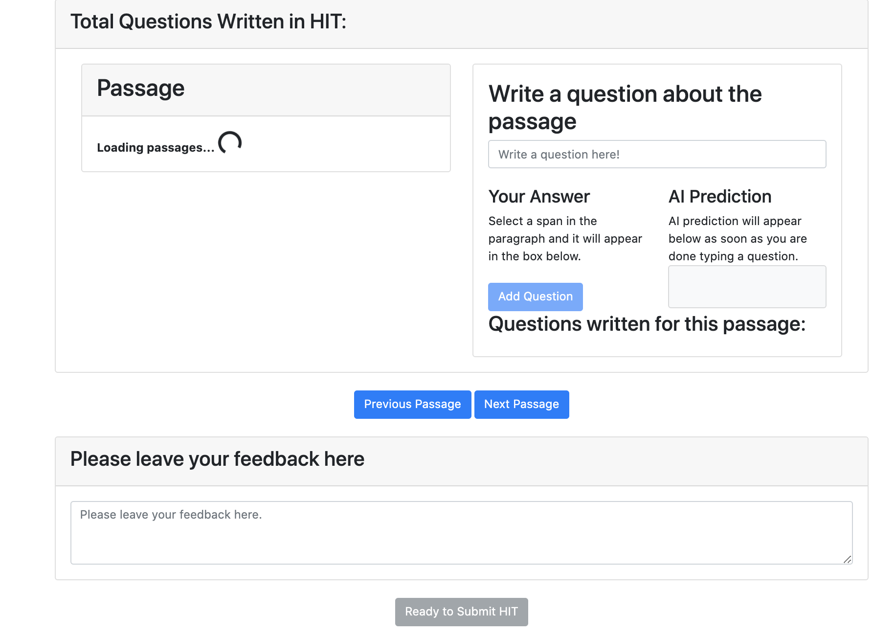
Splitting Templates into Tasks
Task1
Split each template into tasks
Task2
Each task is one self-contained annotation step
Input of each task is either external data like passages or output(s) of some of the earlier steps in annotation
The output is purely collected from crowdworker annotation.
Task3
Task4
Task1
Task2

Slide 122
Experiment: Random Split Generalization
Is there any value in out-of-format training?
40
30
20
10
0
Mixing RACE (Multiple-Choice) w/ datasets of different formats.
69.4
62.5
59.1
55.8
Notes:
The first intuition that one needs to verify is whether there is any value in mixing pairs of datasets.
(read the plots)
I don’t know about you, but when I was seeing these improvements, my first instinct was that there must be a bug somewhere.
Quite surprising how one can gain so much by creating these seemingly odd combinations.
--> more experiments in the paper Overall, empirically we see that there exists pairs of datasets with different formats that benefit from each other.
This brings us to the question of what happens when you mix multiple datasets of different format?

Slide 123
Motivation: Cross-Task Generalization
Text: She chose to make a salad for lunch tomorrow and Sunday. Question: how long did it take for her to make a salad?
“30mins”, “an hour”
“event duration”
“a valid question”
Question Answering
Question Typing
Grammar Checker
Notes:
Obviously, there are many tasks that we would like to solve in NLP.
For example, given this input which contains a text and a question, we’d like models that answer this question, type this question, for detect its writing/grammatical issues and so many others tasks.
In the current conventional paradigm, what we do is to build models for each task, typically based based on datasets built for one one.
This convention works well for individual datasets (we have good systems that work well for each dataset)
however, none is able to generalize across the tasks
e.g., a question-answering model cannot solve classification tasks.

Slide 124
Motivation: Cross-Task Generalization
Text: She chose to make a salad for lunch tomorrow and Sunday. Question: how long did it take for her to make a salad?
“30mins”, “an hour”
“event duration”
“a valid question”
Question Answering
Question Typing
Grammar Checker
Notes:
In contrary, the eutopia that I am after looks like this
Where we have a single system that has a broader scope and can solve a variety of tasks
But to make a model solve a variety of tasks, we should somehow define what expect from the model (or, what task it is solving).

Slide 125
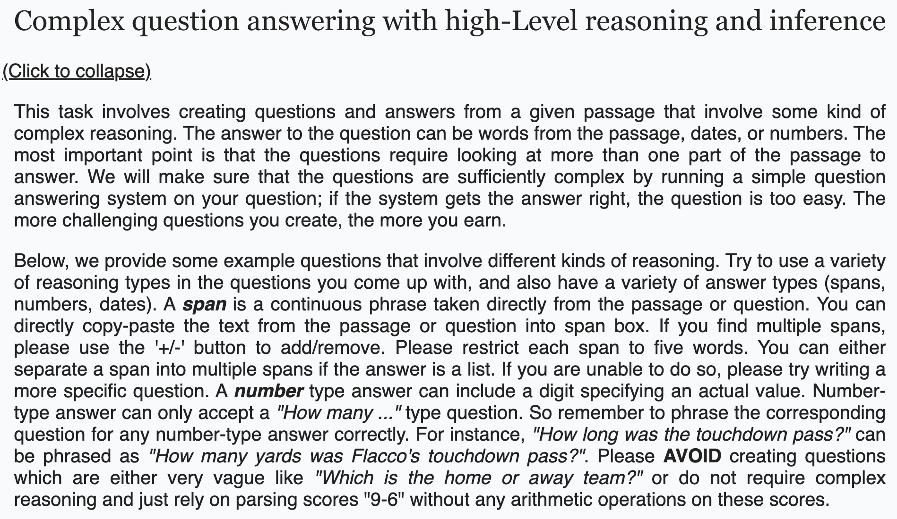
Natural-Instructions: Construction (2)
instructions schema
collecting existing datasets
Definition
Things to Avoid
Emphasize/Caution
Prompt
Positive Examples:
Negative Examples:
Positive example
Positive example
dividing crowdsourcing instructions into minimal tasks
Input
Output
Input
Output
Reason
Reason
Suggestion
instructions schema
mapping crowdsourcing instructions to the schema
DROP [Dua et al. 2019]
Notes:
TODO:
- make it a bit more compact
- just like fig 3, separate instances from the instructions
We drop uncessary sentences:
E.g., below we provide some examples:

Slide 126
Natural-Instructions: Construction (2)
instructions schema
collecting existing datasets
Definition
Things to Avoid
Emphasize/Caution
Prompt
Positive Examples:
Negative Examples:
Positive example
Positive example
dividing crowdsourcing instructions into minimal tasks
Input
Output
Input
Output
Reason
Reason
Suggestion
instructions schema
mapping crowdsourcing instructions to the schema
Notes:
TODO:
- make it a bit more compact
- just like fig 3, separate instances from the instructions

Slide 127
Annotation of Crowdsourcing Template (2)
Instructions:
Title
Definition
Things to Avoid
Emphasize/Caution
Examples:
Positive example
Negative example
Input
Output
Input
Output
Reason
Reason
Suggestion
# of examples for task
Input/outputs:
Prompt message
input
output
# of task instances
# of tasks

Slide 128
Data Curation
Mapping crowdsourcing instructions to our proposed schema:
Retained the original phrasing, converted to the simplest form by removing redundant content.
Created negative examples wherever they were absent.
Added explanations to positive and negative examples wherever applicable.
Fixed annotation issue in examples present in the template wherever applicable.
Kept the instances with high inter-annotator agreement.
Limitations:
Html information (e.g., certain organization of the information boxes) is lost while converting them into our schema.

Slide 129
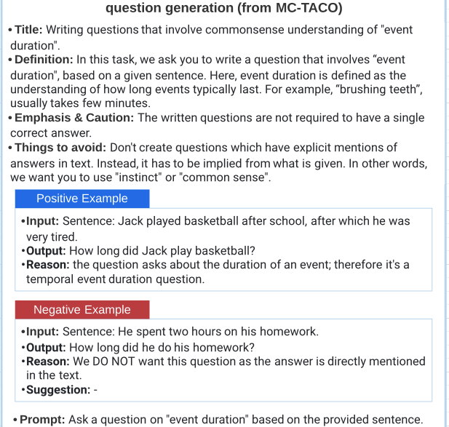
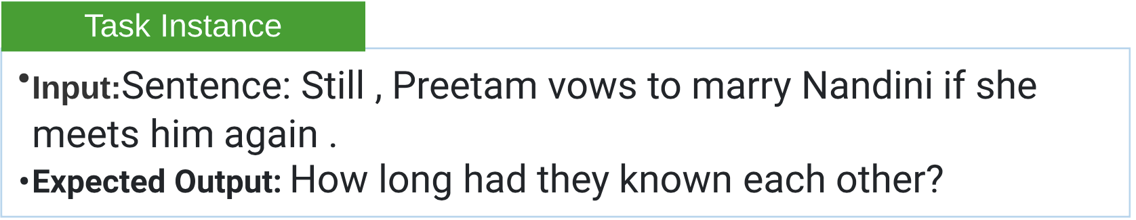
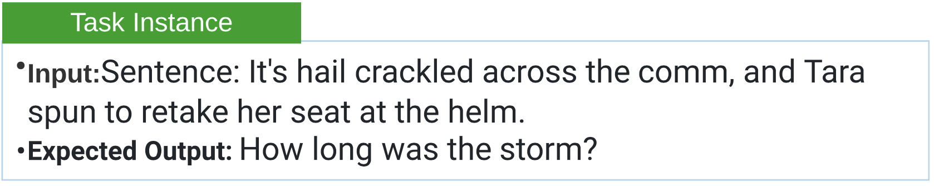
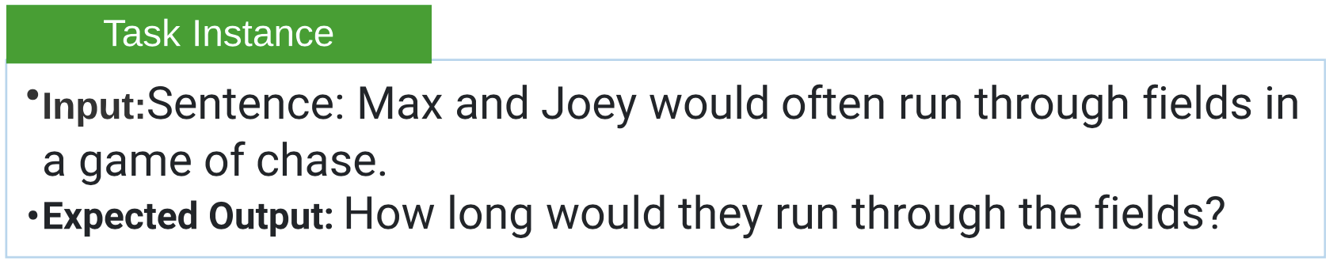
NATURAL INSTRUCTIONS: Examples
Instructions remain common across instances

Slide 130
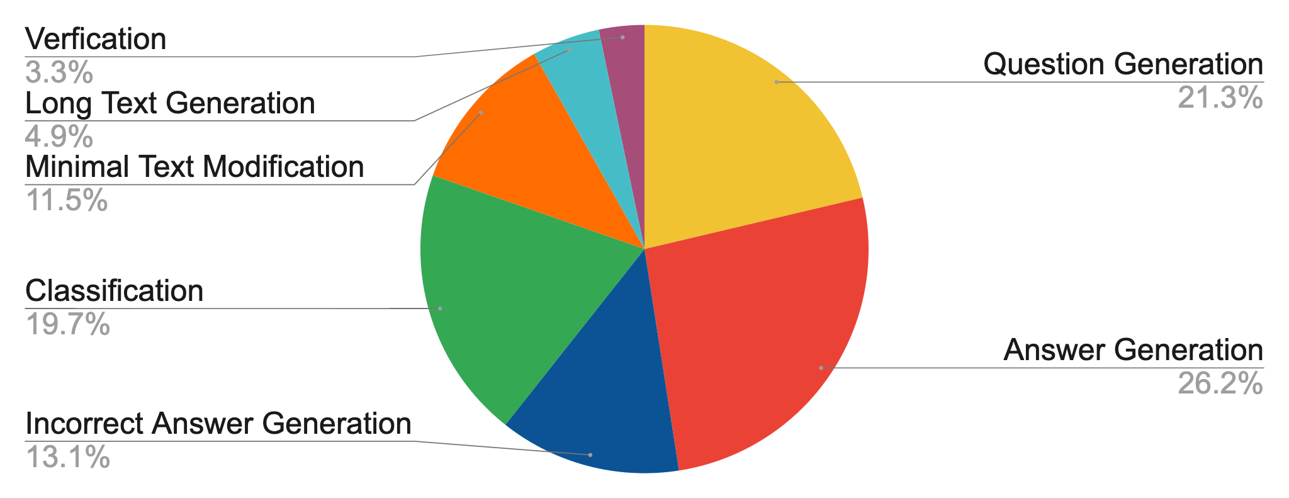
NATURAL-INSTRUCTIONS: Diversity
Tasks: ~61
Categories: ~7
Diverse Reasoning Skills:
E.g. Numerical Reasoning,
Coreference Resolution,
Commonsense Reasoning,
Multihop Reasoning.
A successful model
trained on Natural
Instructions will be a
toolbox for dataset
creation.

Slide 131

NATURAL-INSTRUCTIONS: Size Distribution
Size: ~620k
Biggest Category:
Classification
~194k
Smallest Category:
Long Text Generation
~30k

Slide 132
Experimental Setup
Data Splits
Eval Split (35 tasks) which accept a relatively reliable automatic evaluation.
Non-Eval Split (26 tasks), ensuring representation of each category of task
Models: text to text models
Few Shot GPT-3: prompting it with a few inference-time examples
Generalization BART: supervised with “non-eval” tasks.
Evaluation metrics.
BLEURT
ROUGE-L

Slide 133

Category-wise Analysis of Instruction Benefits
The benefit from
instructions heavily
depends on the task
at hand.
For GPT-3 (left)
minimal text modification
category benefits a lot from
following instructions,
while the benefits to the
verification tasks are minimal.

Slide 134
Ablation of Instruction Encodings
GPT-3 on 3 distinct tasks
answer generation from Winogrande;
question generation from QASC;
verifying temporal reasoning
category of a given question
from MCTACO
59
56
54
Percentage Improvement
on “Prompt”
only encoding
23
GPT-3 benefits the most from positive
Examples, mildly from definition and
deteriorates with negative examples.
15
10
-13
Definition
Def &
Pos Ex.
Emphasis
Pos. Ex.
Things to Avoid
Pos. &
Neg. Ex.
Neg. Ex.

Slide 135
Results: Generalization Experiments
Task Specific Model
Instructions improve
generalization to unseen
tasks.
0.63
Instructions also improve
few shot performance.
ROUGE
0.28
0.27
0.26
0.24
0.24
0.22
0.17
0.16
NATURAL-INSTRUCTIONS has a wide margin to be solved.
0.14
Instance only
Prompt
Prompt+Def.
Pos. Ex.
All Instructions
BART GPT3

Slide 136
Encoding Instructions
Text: She chose to make a salad for lunch tomorrow and Sunday.
“Duration” question generation task
Definition: In this task, we ask you to write a question that involves “event duration", based on a given sentence. Here, event duration is defined as the understanding of how long events typically last. For example, “brushing teeth”, usually takes few minutes.
enc(.)
“how long did it take for her to make a salad?
Emphasize/Caution: The written questions are not required to have a single correct answer.
Things to Avoid: Don't create questions which have explicit mentions of answers in text. Instead, it has to be implied from what is given. In other words, we want you to use "instinct" or "common sense".
text to text architectures:
BART [Lewis et al. 2019]
GPT3 [Brown et al. 2020]
Positive example 1
Input: Sentence: Jack played basketball after school, after which he was very tired.
Output: How long did Jack play basketball?
Reason: The question asks about the duration of an event; therefore it's a temporal event duration question.
…
Notes:
… to be precise, the instructions are given to a function that encodes them into as text.
-----------
Should I provide more details?

Slide 137
Variation of Input Encodings
Input Encodings
Instance only
Encoded-input: “input: ${input} output:”
Prompt
Encoded-input: “prompt:${prompt} input: ${input} output:”
Prompt and Definition
Positive Examples only
All Instructions
Encoded-input: “def: ${def} prompt:${prompt} input: ${input} output:”

Slide 138
“definition: ${def}
things to avoid: ${avoid}
emphasis/caution: ${emphasis}
Positive example1:
input: ${ex_in}, output: ${ex_out}, reason: ${ex_reas}
prompt:${prompt}
input: ${input}
output:”

